Slide 1
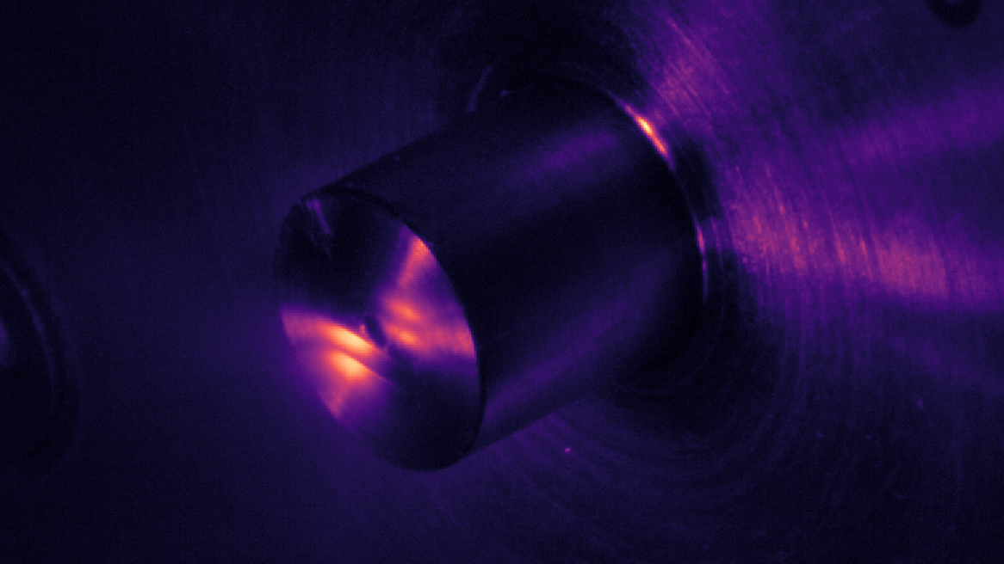
Complex Attosecond Transient-absorption
Spectroscopy
Stephen J. Hageman
Agostini-DiMauro Ultrafast Atomic Physics Research Group
Ph.D. Dissertation Defense
Dec. 8, 2020

Slide 2
Academic History
B.S. Physics and Mathematics, Johns Hopkins University……………………………………………………….................
Entered OSU physics graduate program………………………………………………………….........................................
Completed candidacy exam……………………………………………………………………………………………………………….....
M.S. Physics, OSU…………………………………………………………………………………………………………………………………..
2011
2012
2014
2014
Publication List
Cr:ZnSe mid-IR, multi-mJ, few-cycle amplifier: a new platform for attosecond soft-X-ray physics
V. E. Leshchenko, B. K. Talbert, Y. H. Lai, S. Li, Y. Tang, S. J. Hageman, G. Smith, P. Agostini, L. F. DiMauro, and C. I. Blaga, Optica 7 (8), 981-988 (2020)
High relative-phase precision beam duplicator for mid-infrared femtosecond pulses
A. Camper, H. Park, S. J. Hageman, G. Smith, T. Auguste, P. Agostini, and L. F. DiMauro, Optics Letters, 44 (22), 5465-5468 (2019)
Epitaxial films of Heusler compound Co₂FeAl_{0.5}Si_{0.5} with high crystalline quality grown by off-axis sputtering
B. Peters, A. Alfonsov, C. G. F. Blum, S. J. Hageman, P. M. Woodward, S. Wurmehl, B. Büchner, and F. Y. Yang, Appl. Phys. Lett. 103, 162404 (2013)
Parallel fabrication of magnetic tunnel junction nanopillars by nanosphere lithography
W. G. Wang, A. Pearse, M. Li, S. Hageman, A. X. Chen, F. Q. Zhu, and C. L. Chien, Scientific Report 3, 1948 (2013)
Electric-field-assisted switching in magnetic tunnel junctions
W. G. Wang, M. Li, S. Hageman, and C. L. Chien, Nature Mater. 11, 64 (2012)
Thermal annealing study of magnetoresistance and perpendicular anisotropy in magnetic tunnel junctions based on MgO and CoFeB
W. G. Wang, S. Hageman, M. Li, S. X. Huang, X. M. Kou, X. Fan, J. Q. Xiao, and C. L. Chien, Appl. Phys. Lett. 99, 102502 (2011)

Slide 3
Outline
Introduction: Attosecond transient-absorption spectroscpy
Experimental Apparatus: Transient absorption beamline (TABLe)
Experimental Investigations
Two-source High Harmonic Generation
Measurement of Refractive Index using SWPG
Attosecond Transient-absorption Spectroscopy of Argon Fano Resonances
Complex Attosecond Transient-absorption Spectroscopy

Slide 4

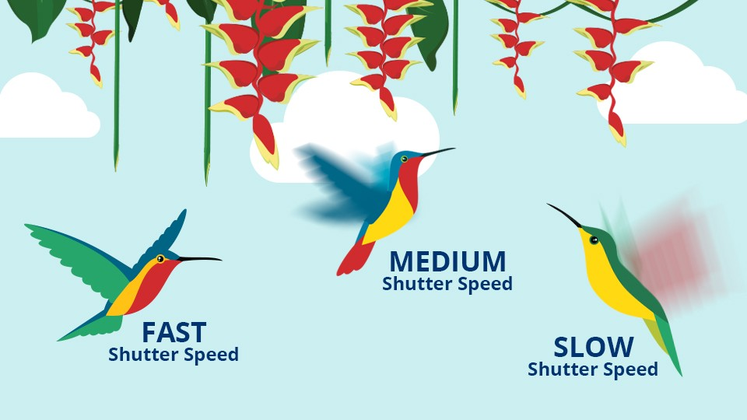
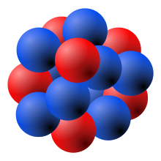
Introduction: Attosecond Probing of Electron Dynamics with Ultrafast Lasers
How fast of a camera shutter speed do we need to image an electron moving around a nucleus?
How fast of a camera shutter speed do we need to image a hummingbird’s wing?
*
Wings flap 10-15 times per second or every ~ 80 ms (80 x 10⁻³ s)
Electron orbits hydrogen nucleus 6.67 x 10¹⁵ times per second, every 150 as (10⁻¹⁸ s)
Wings flap 10-15 times per second or every ~ 80 ms (80 x 10⁻³ s)
*https://www.bhphotovideo.com/explora/photography/tips-and-solutions/understanding-exposure-part-3-shutter-speed

Slide 5

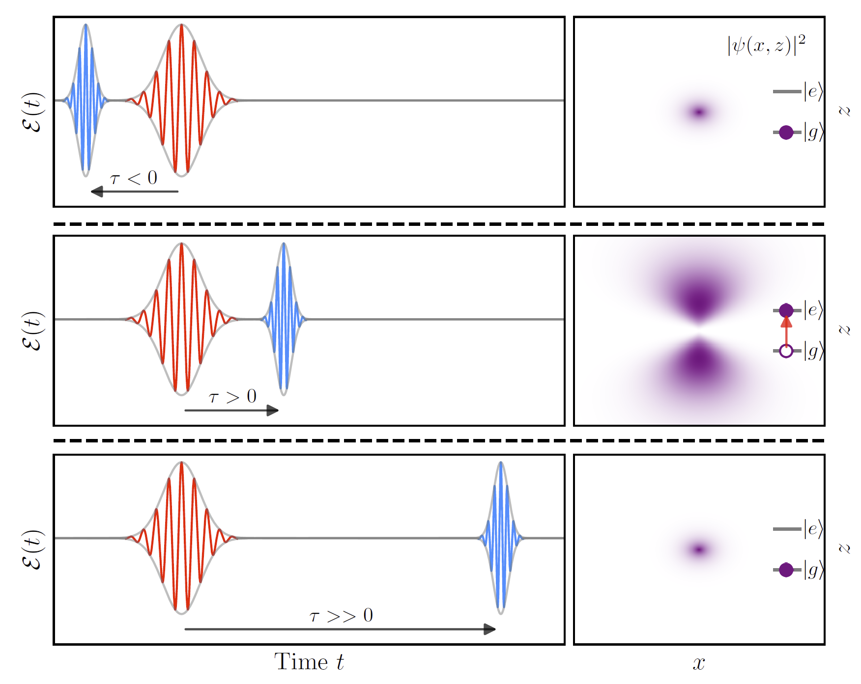
Introduction to pump-probe techniques

Slide 6
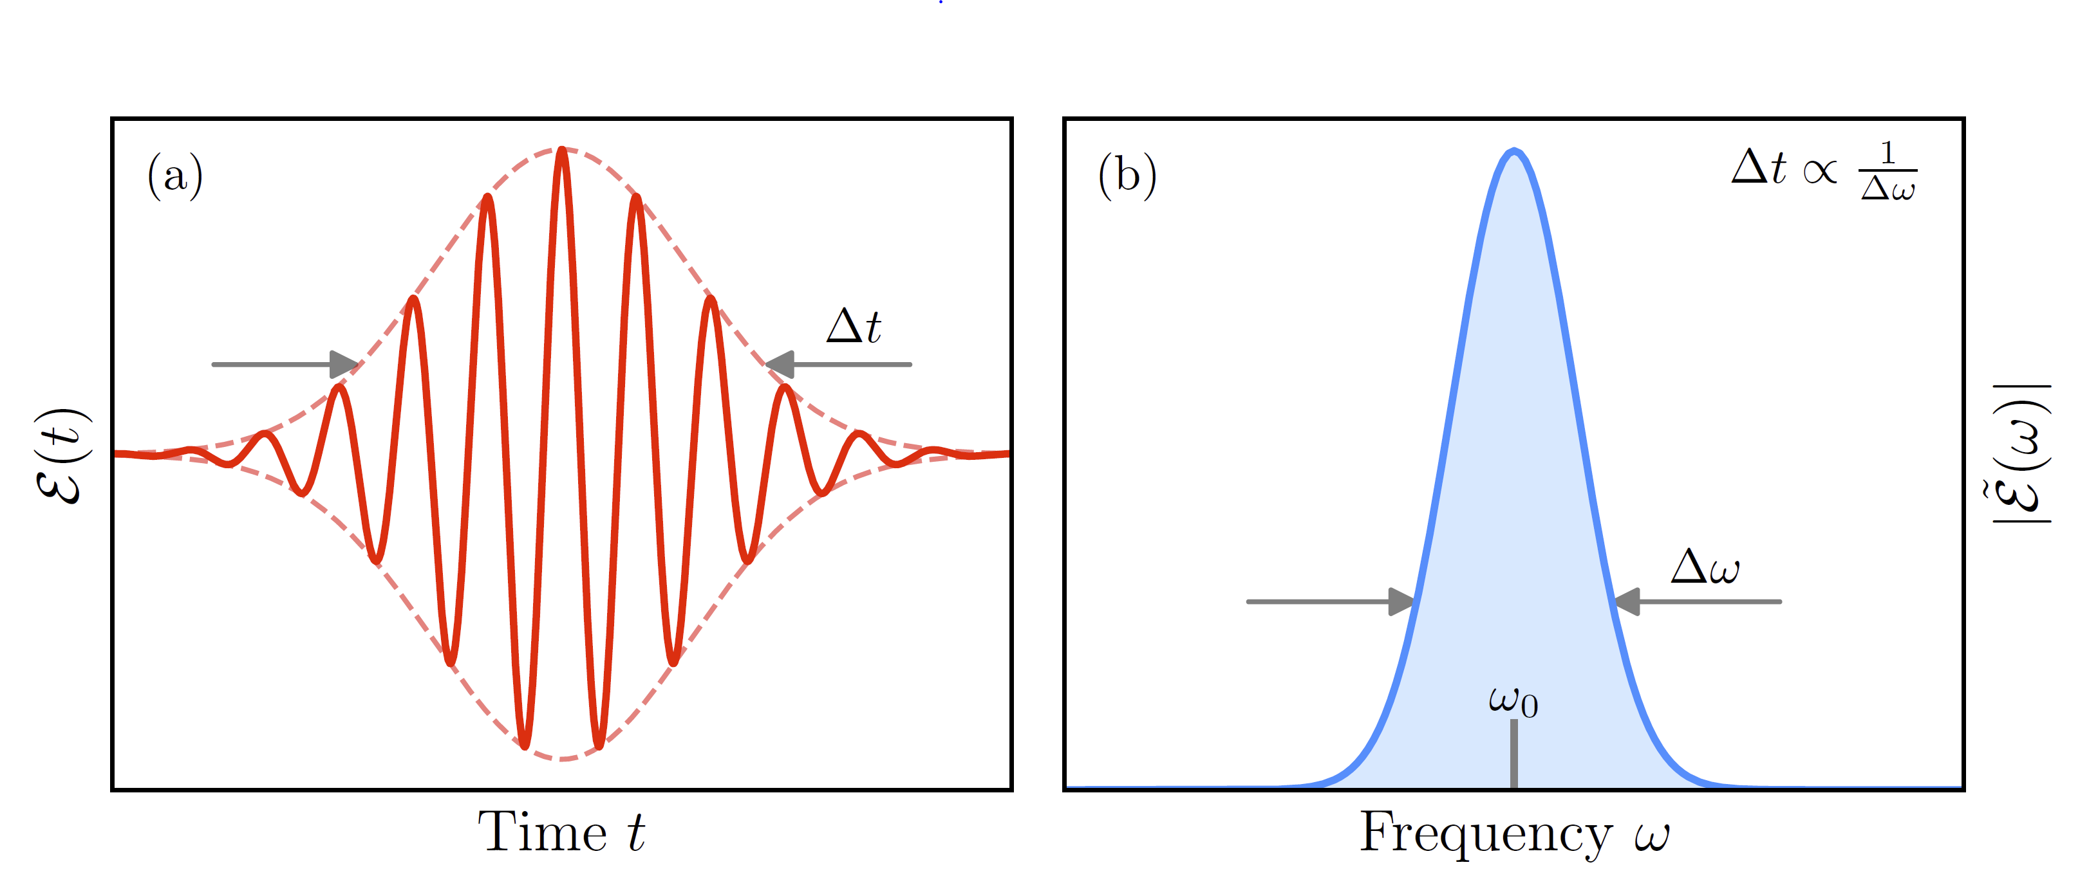
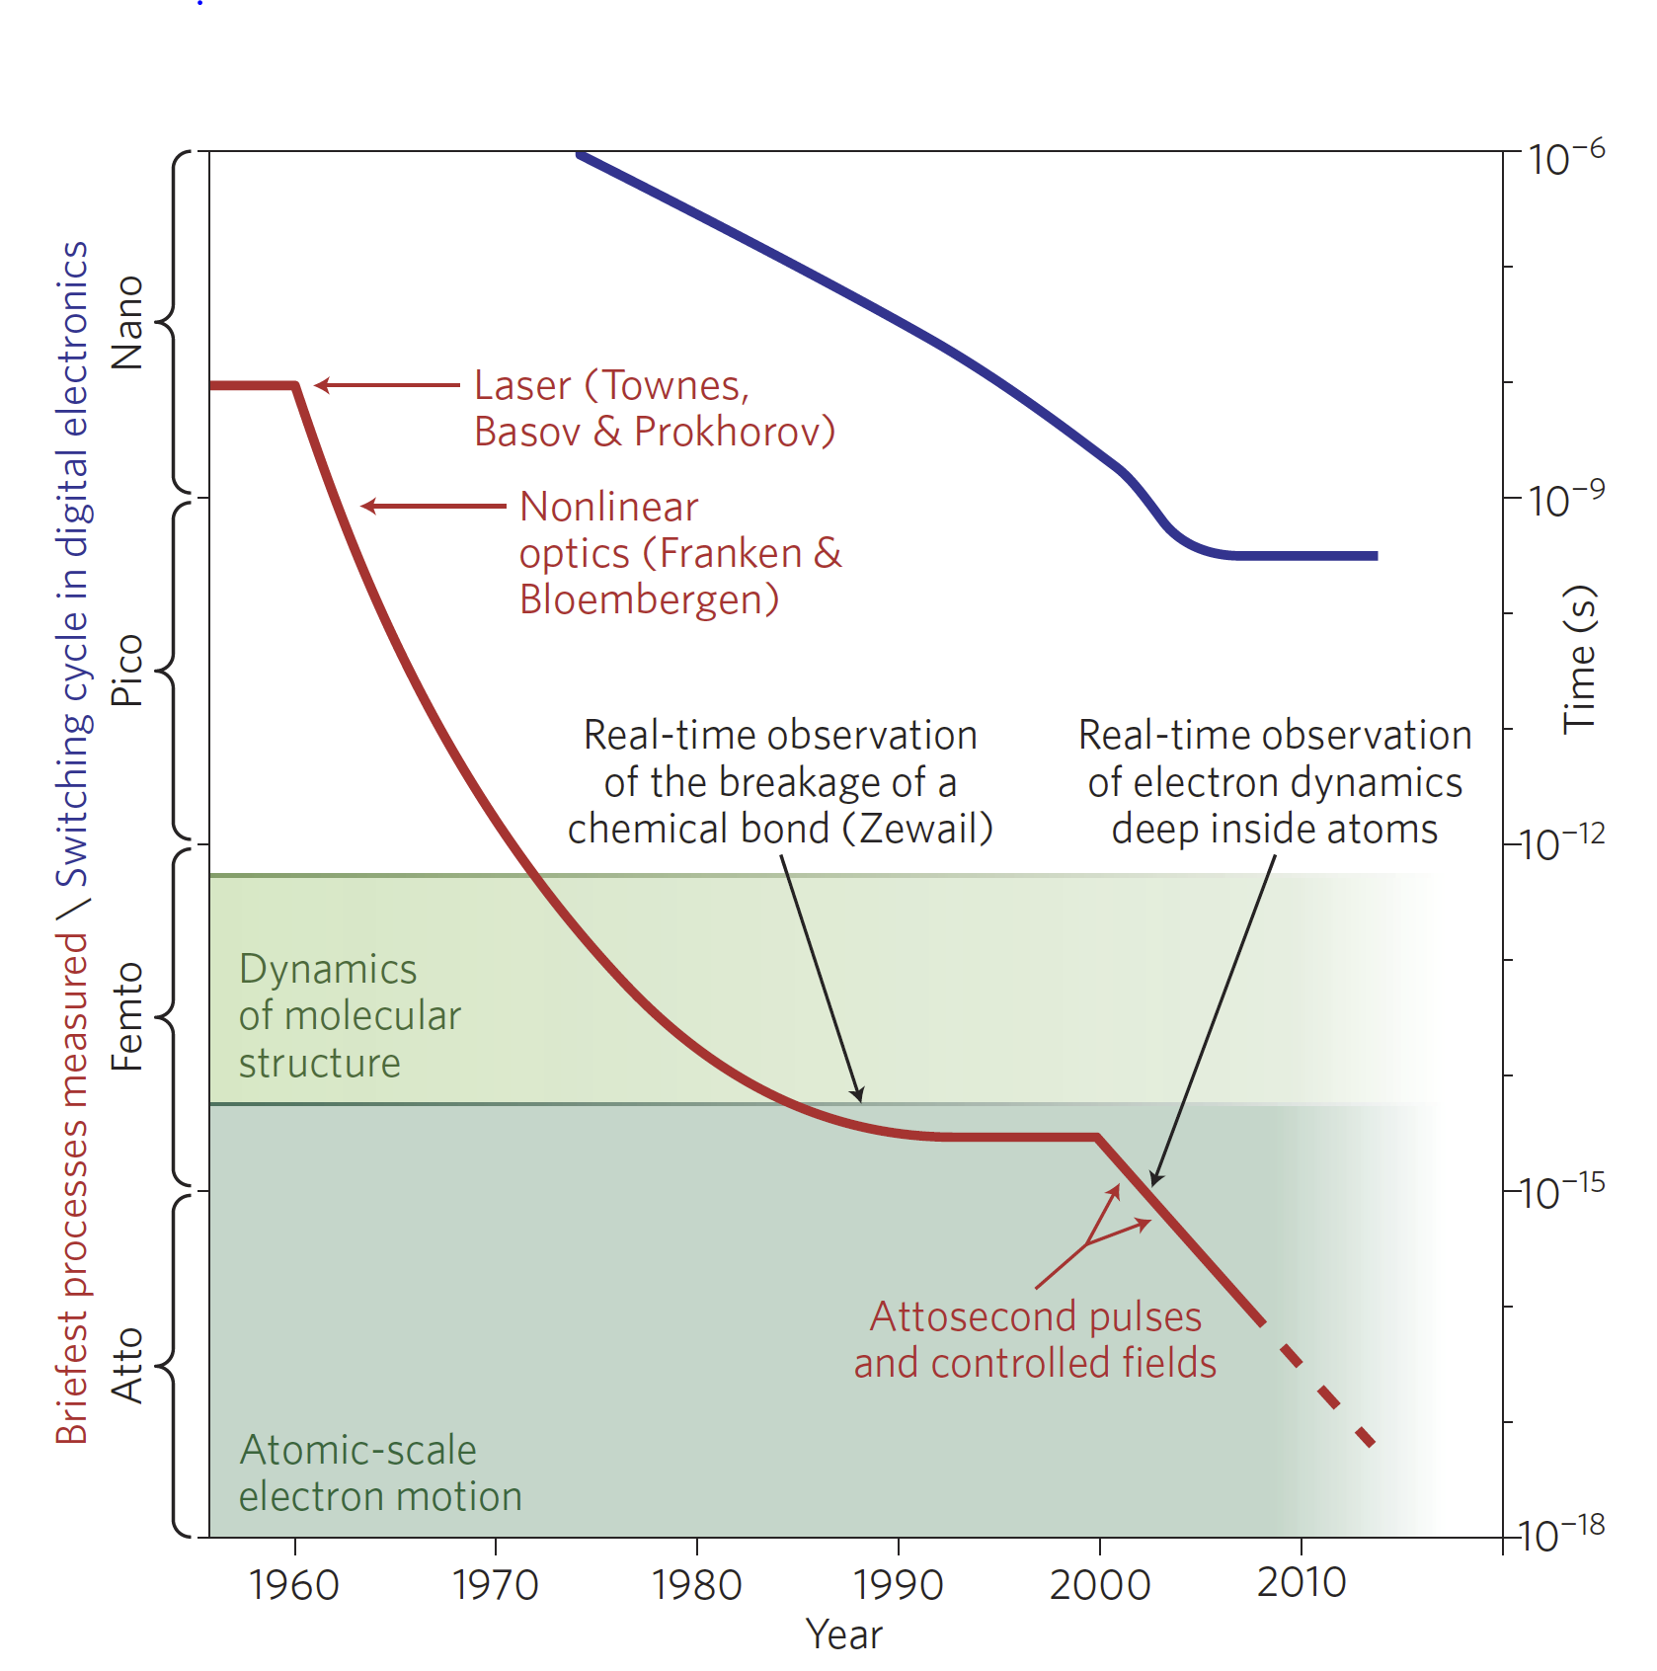
Ultrashort Laser Pulses

Slide 7
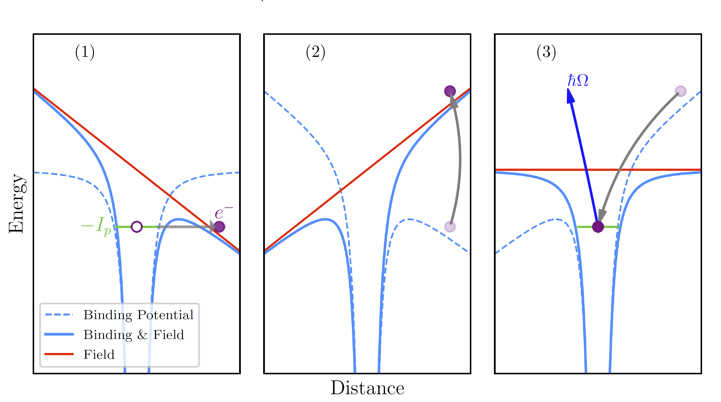
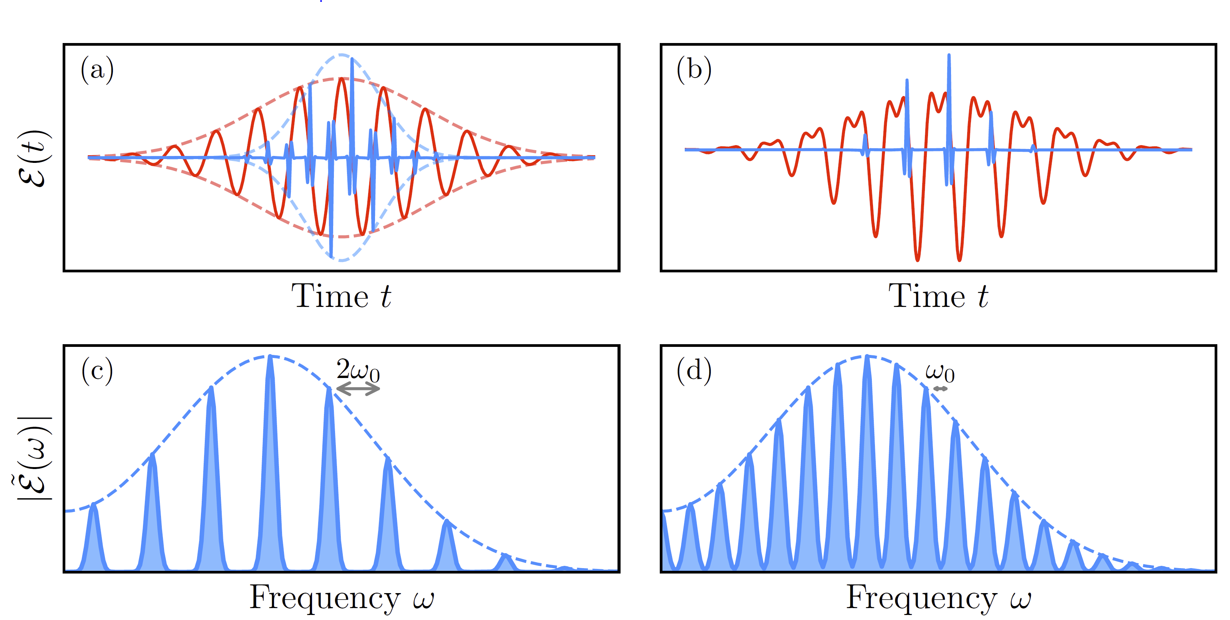
High-harmonic generation (HHG)

Slide 8
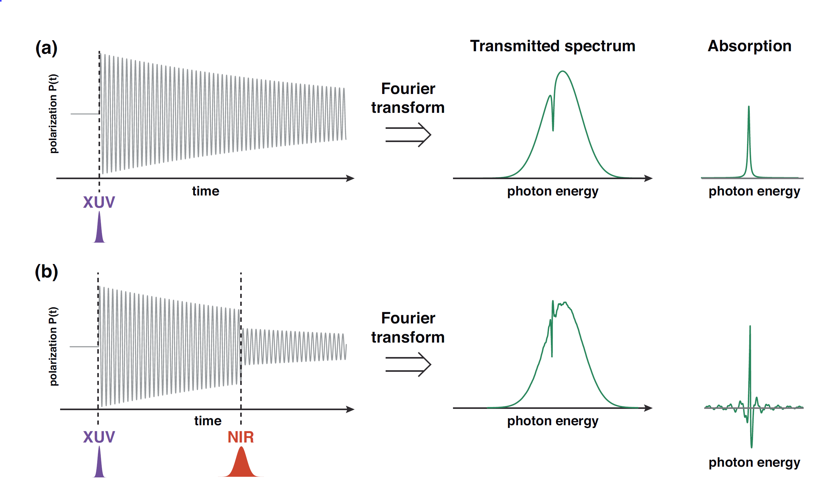
Attosecond Transient Absorption Spectroscopy

Slide 9
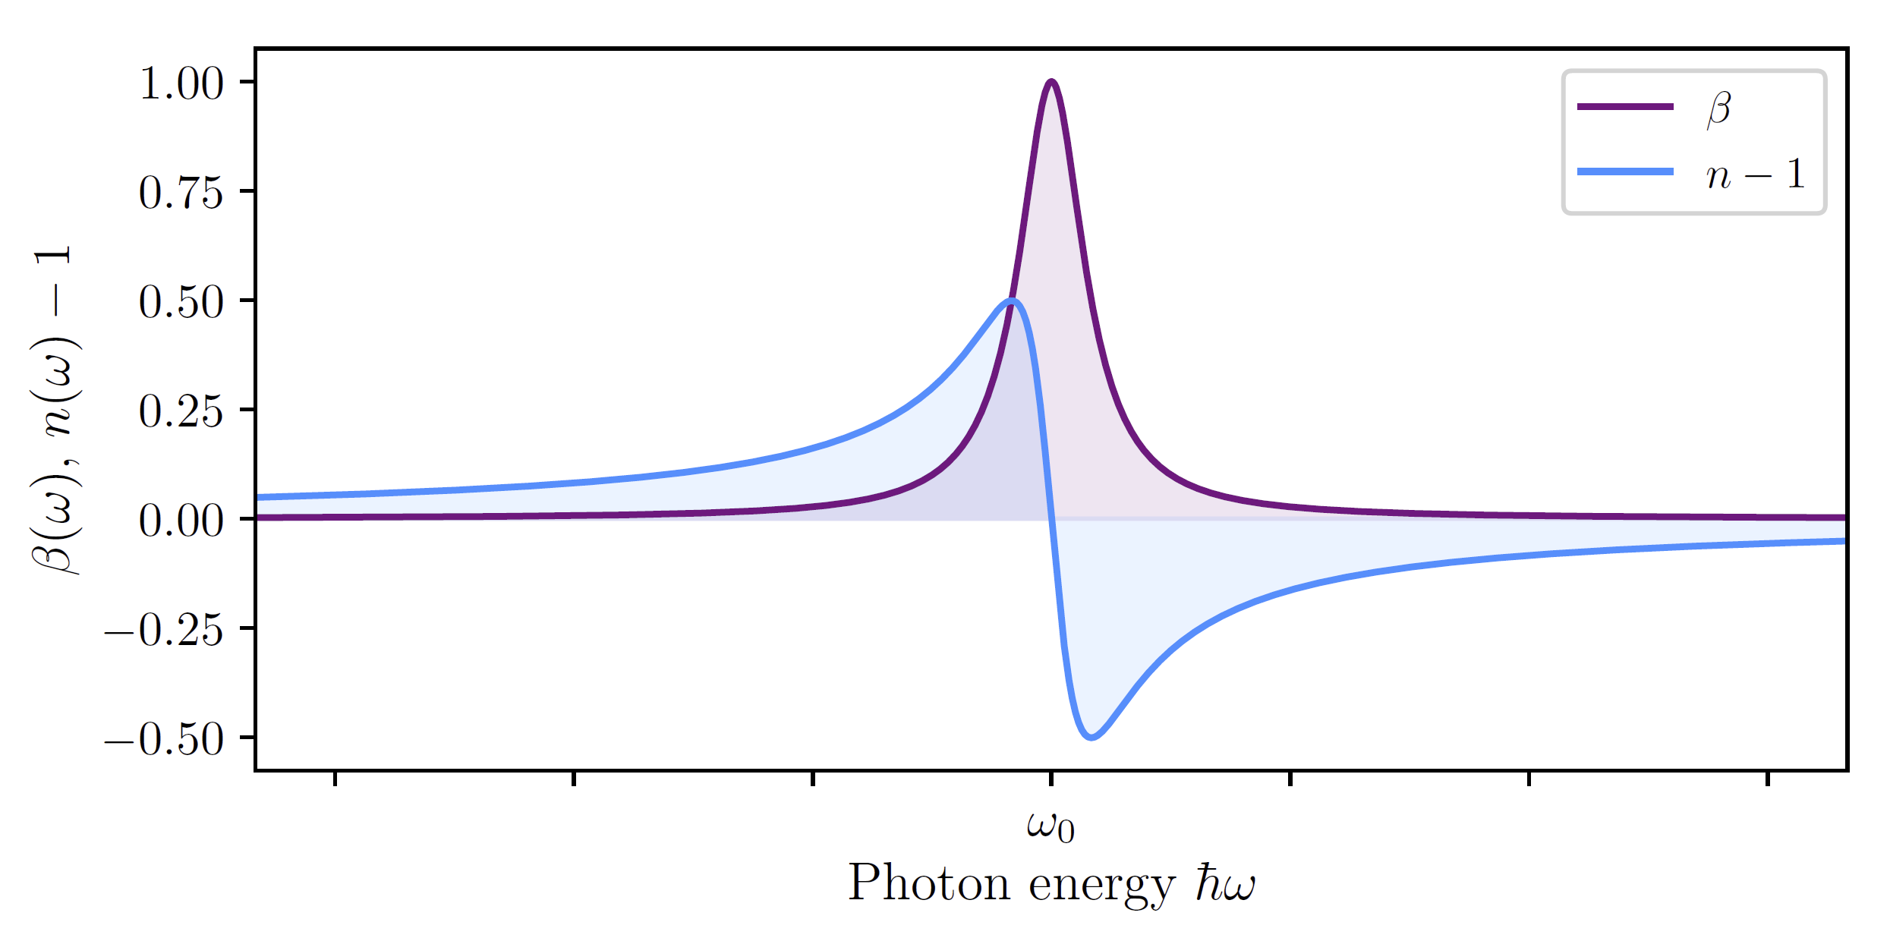
Attosecond Transient Absorption Spectroscopy
?

Slide 10
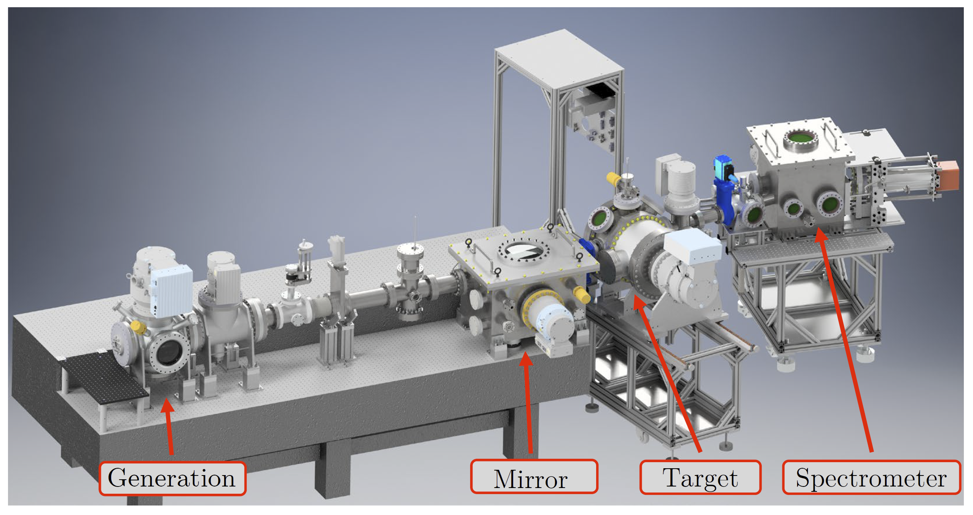
Transient Absorption Beamline (TABLe)

Slide 11
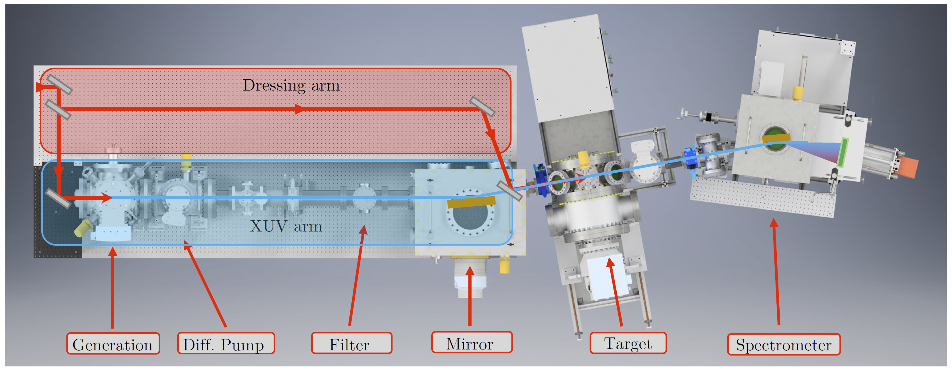
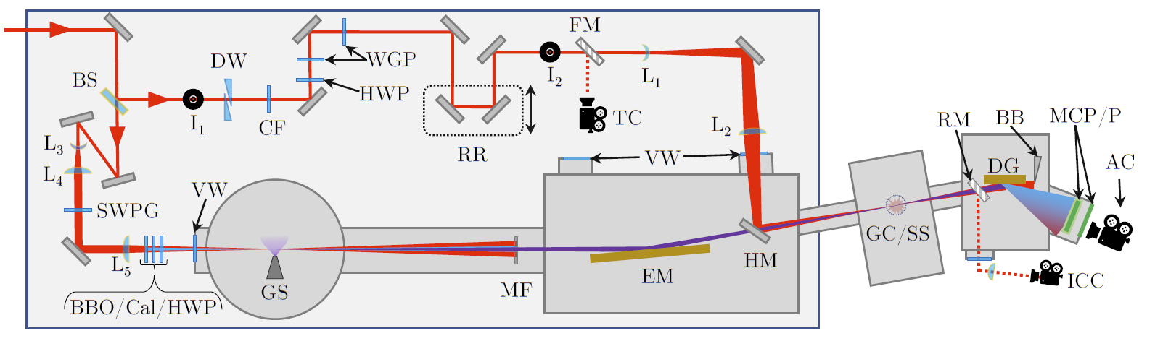

Slide 13
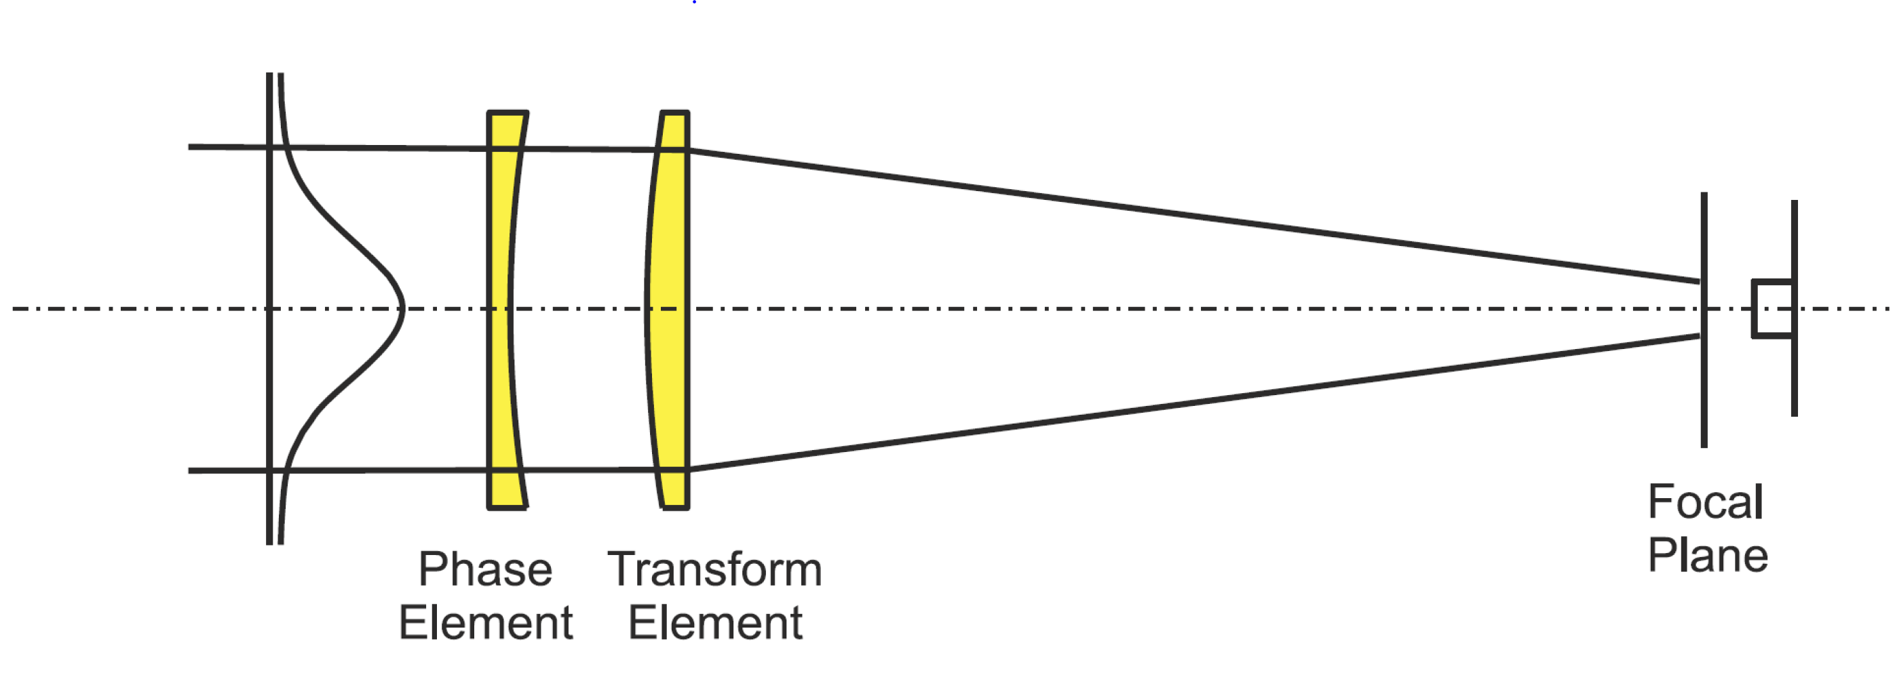
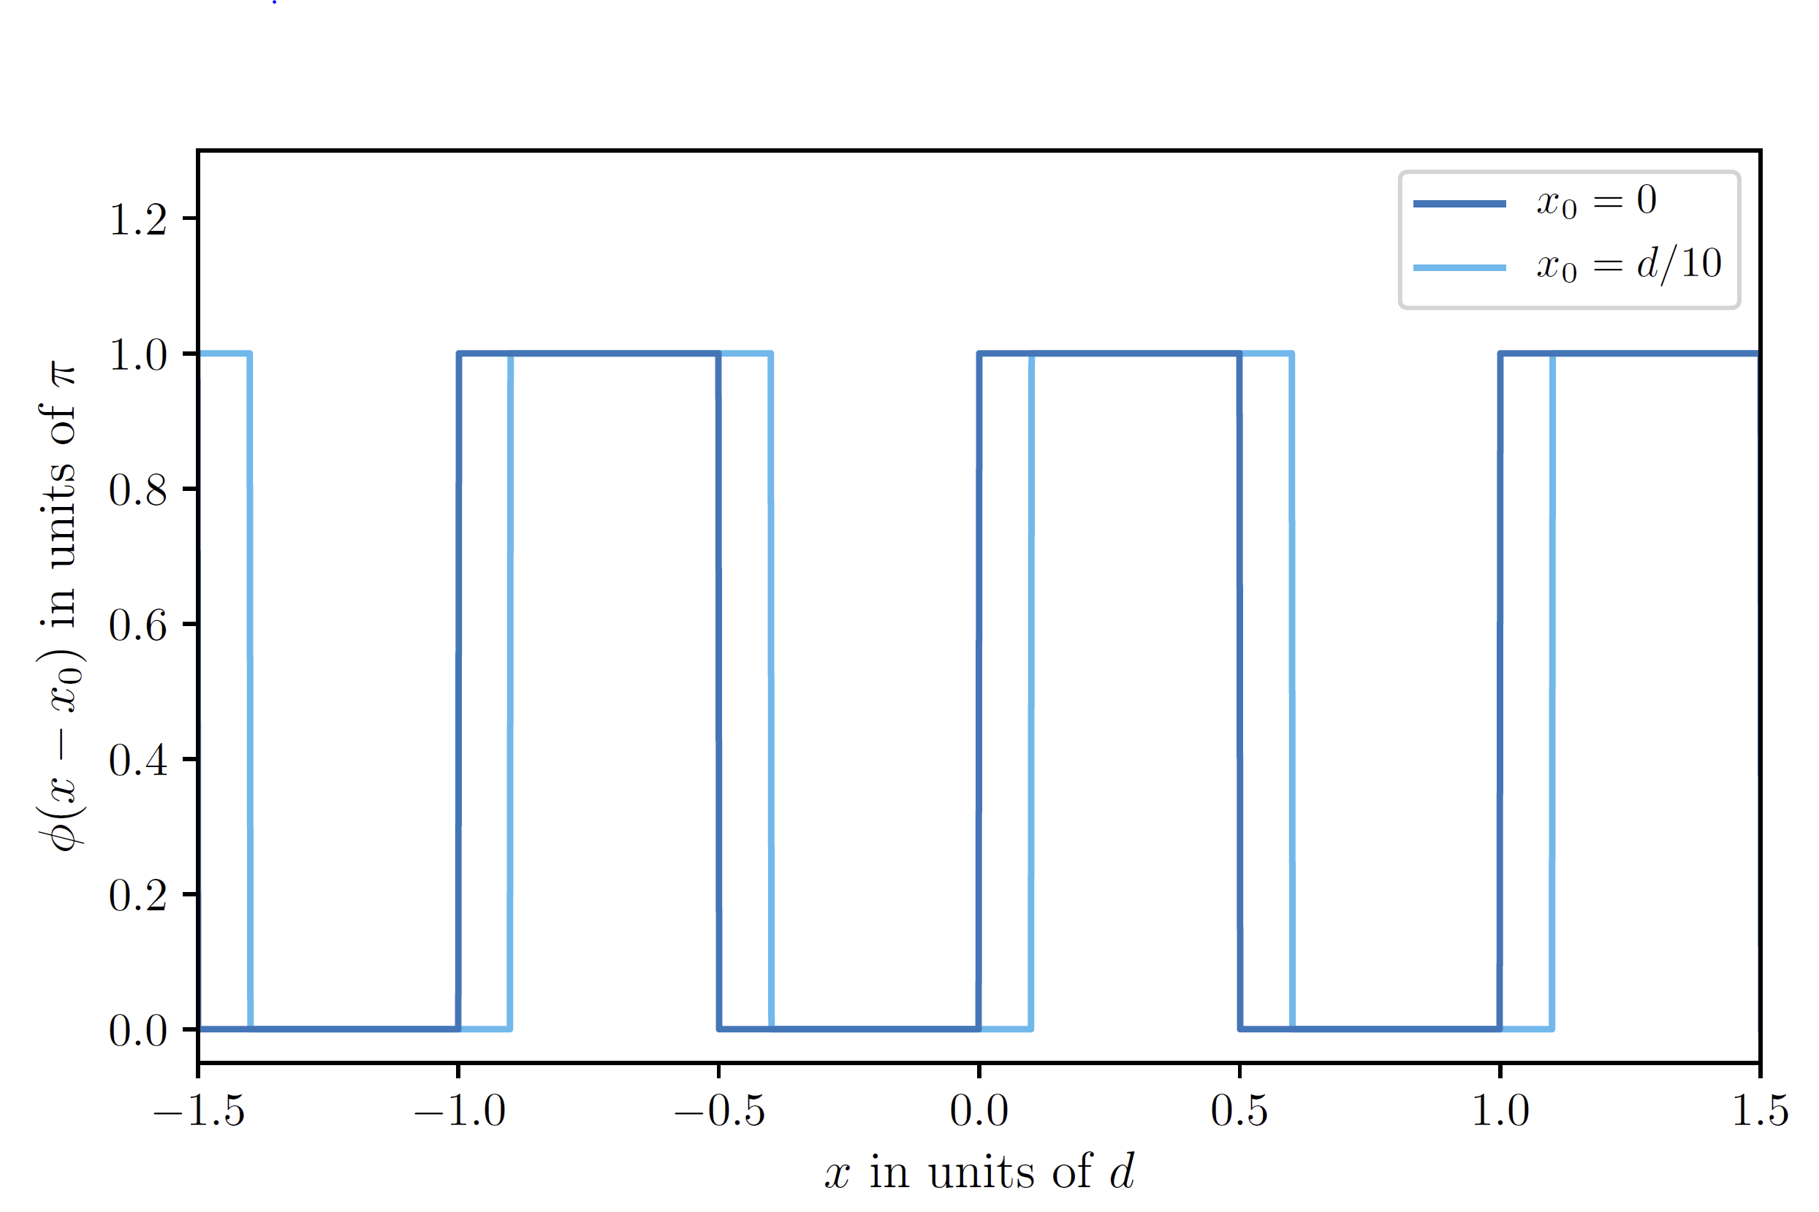
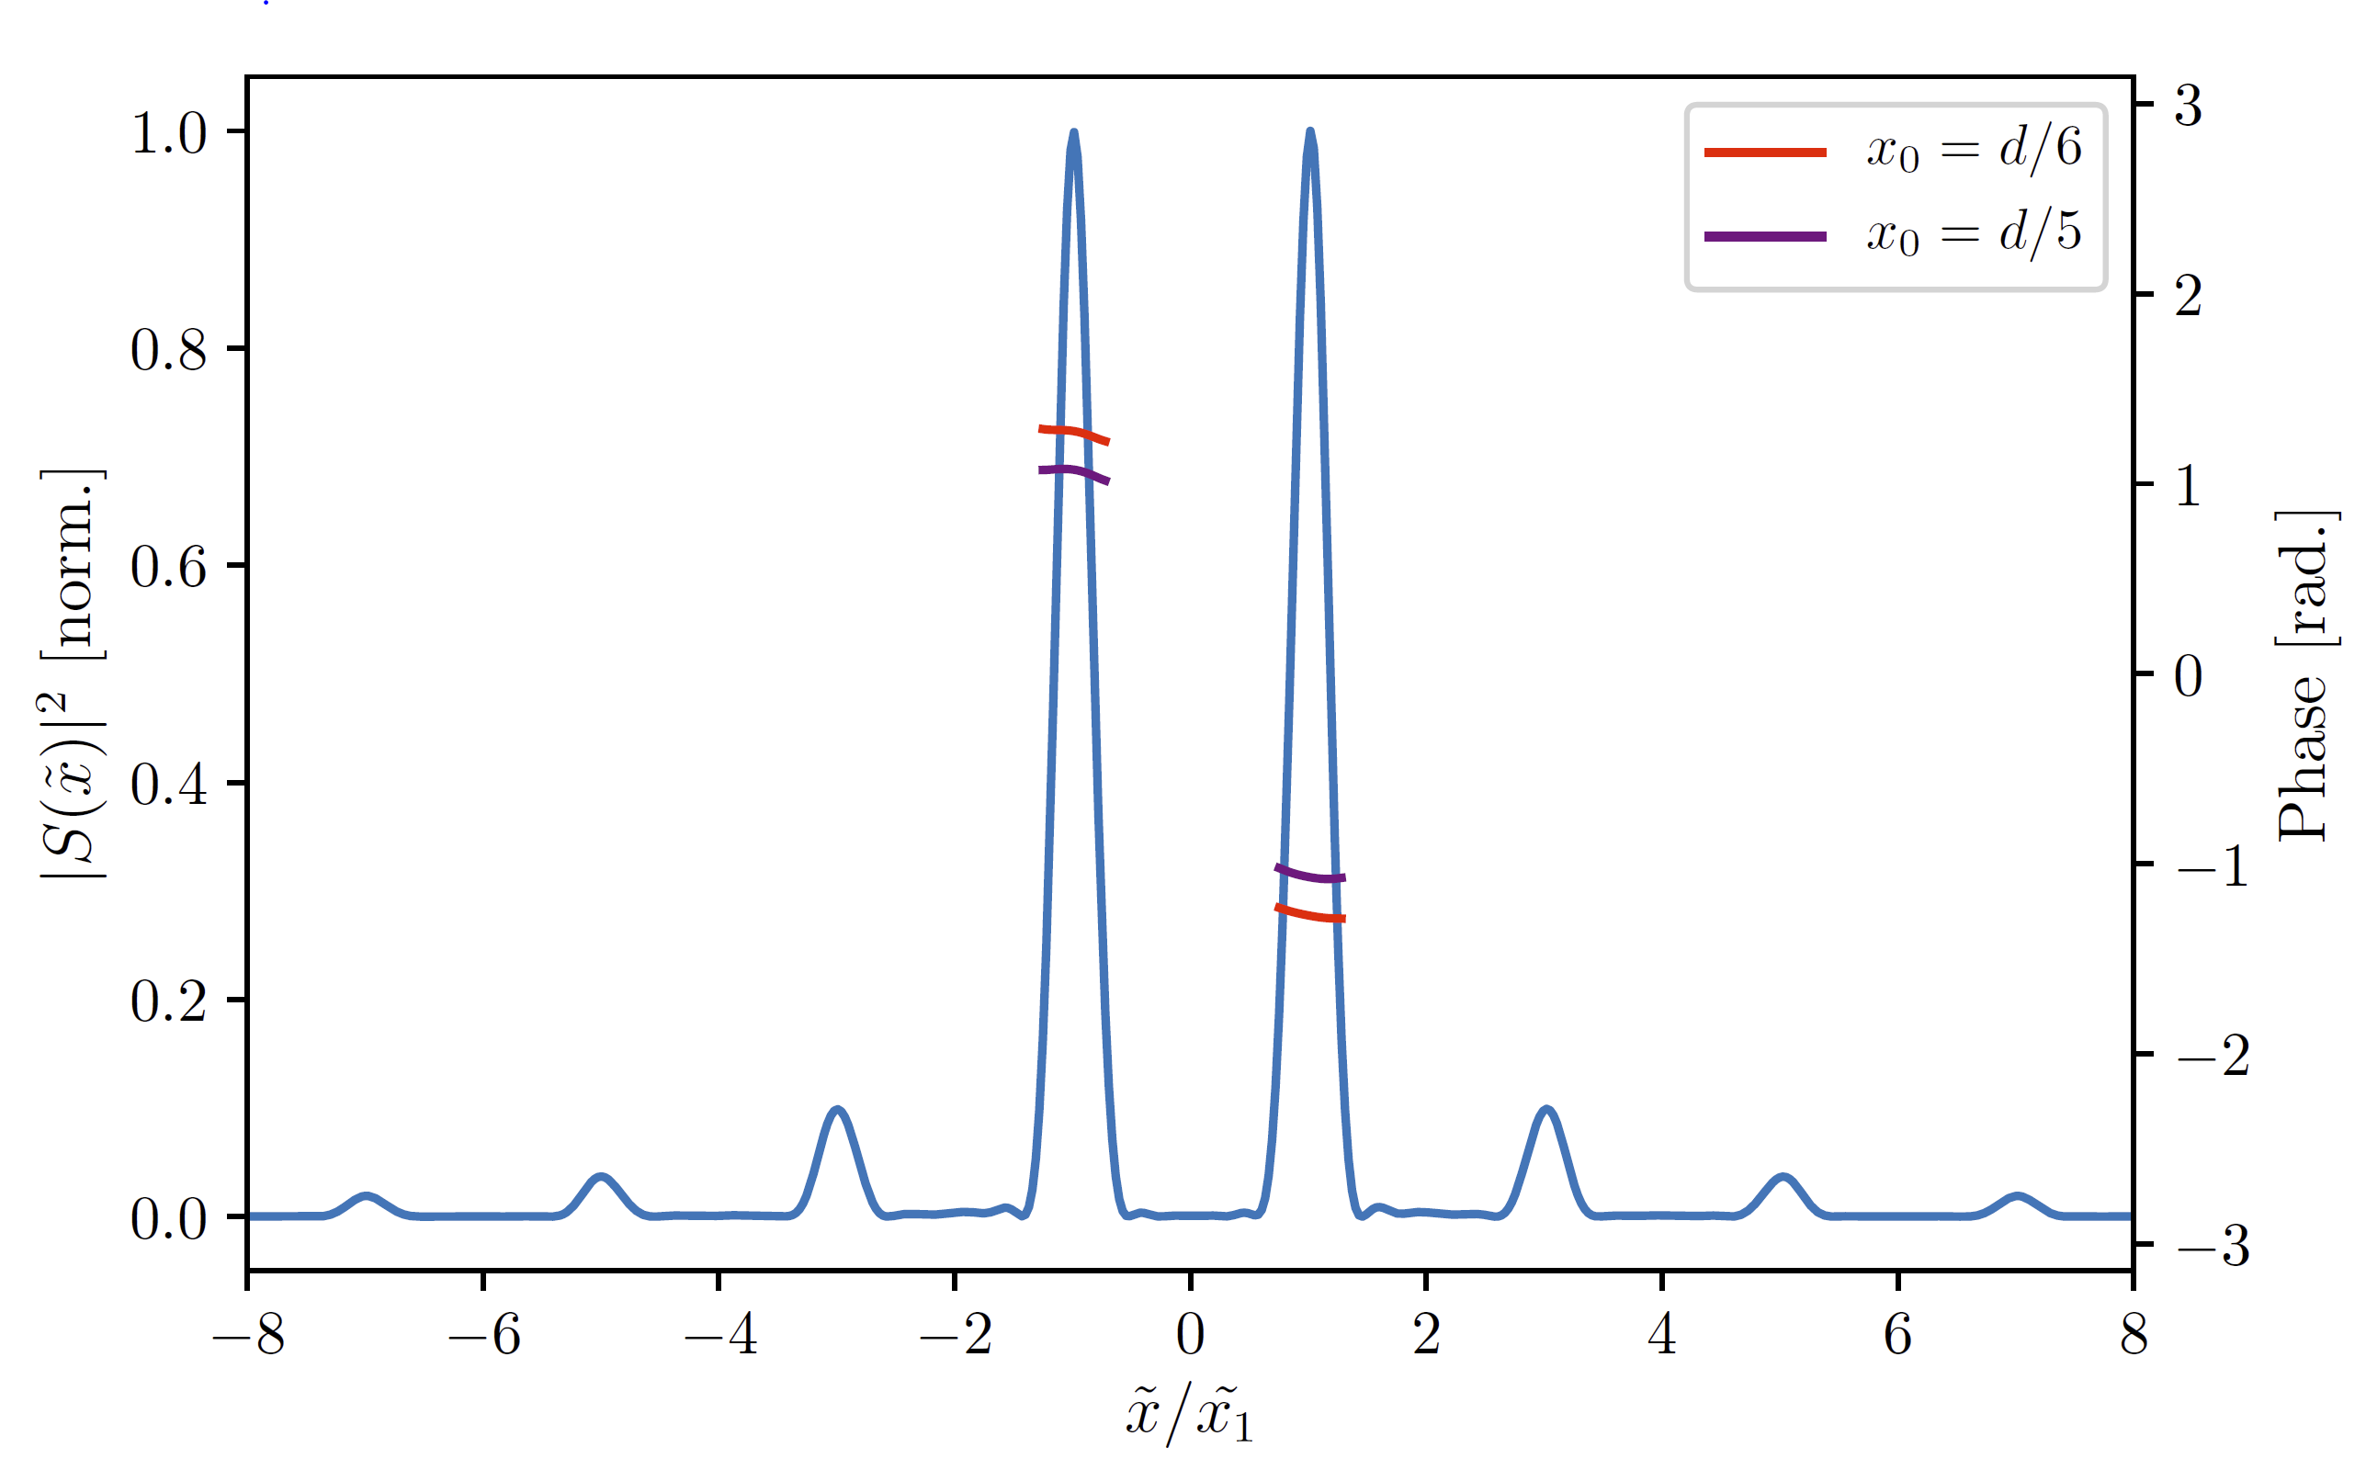

Slide 14
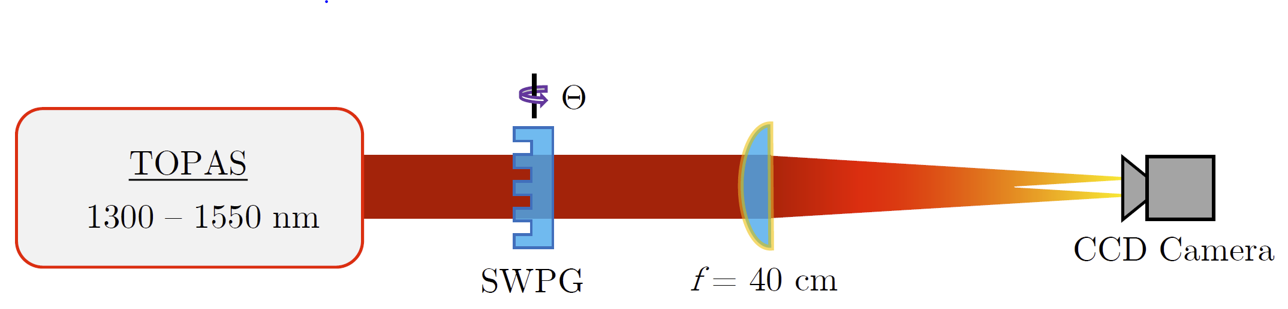
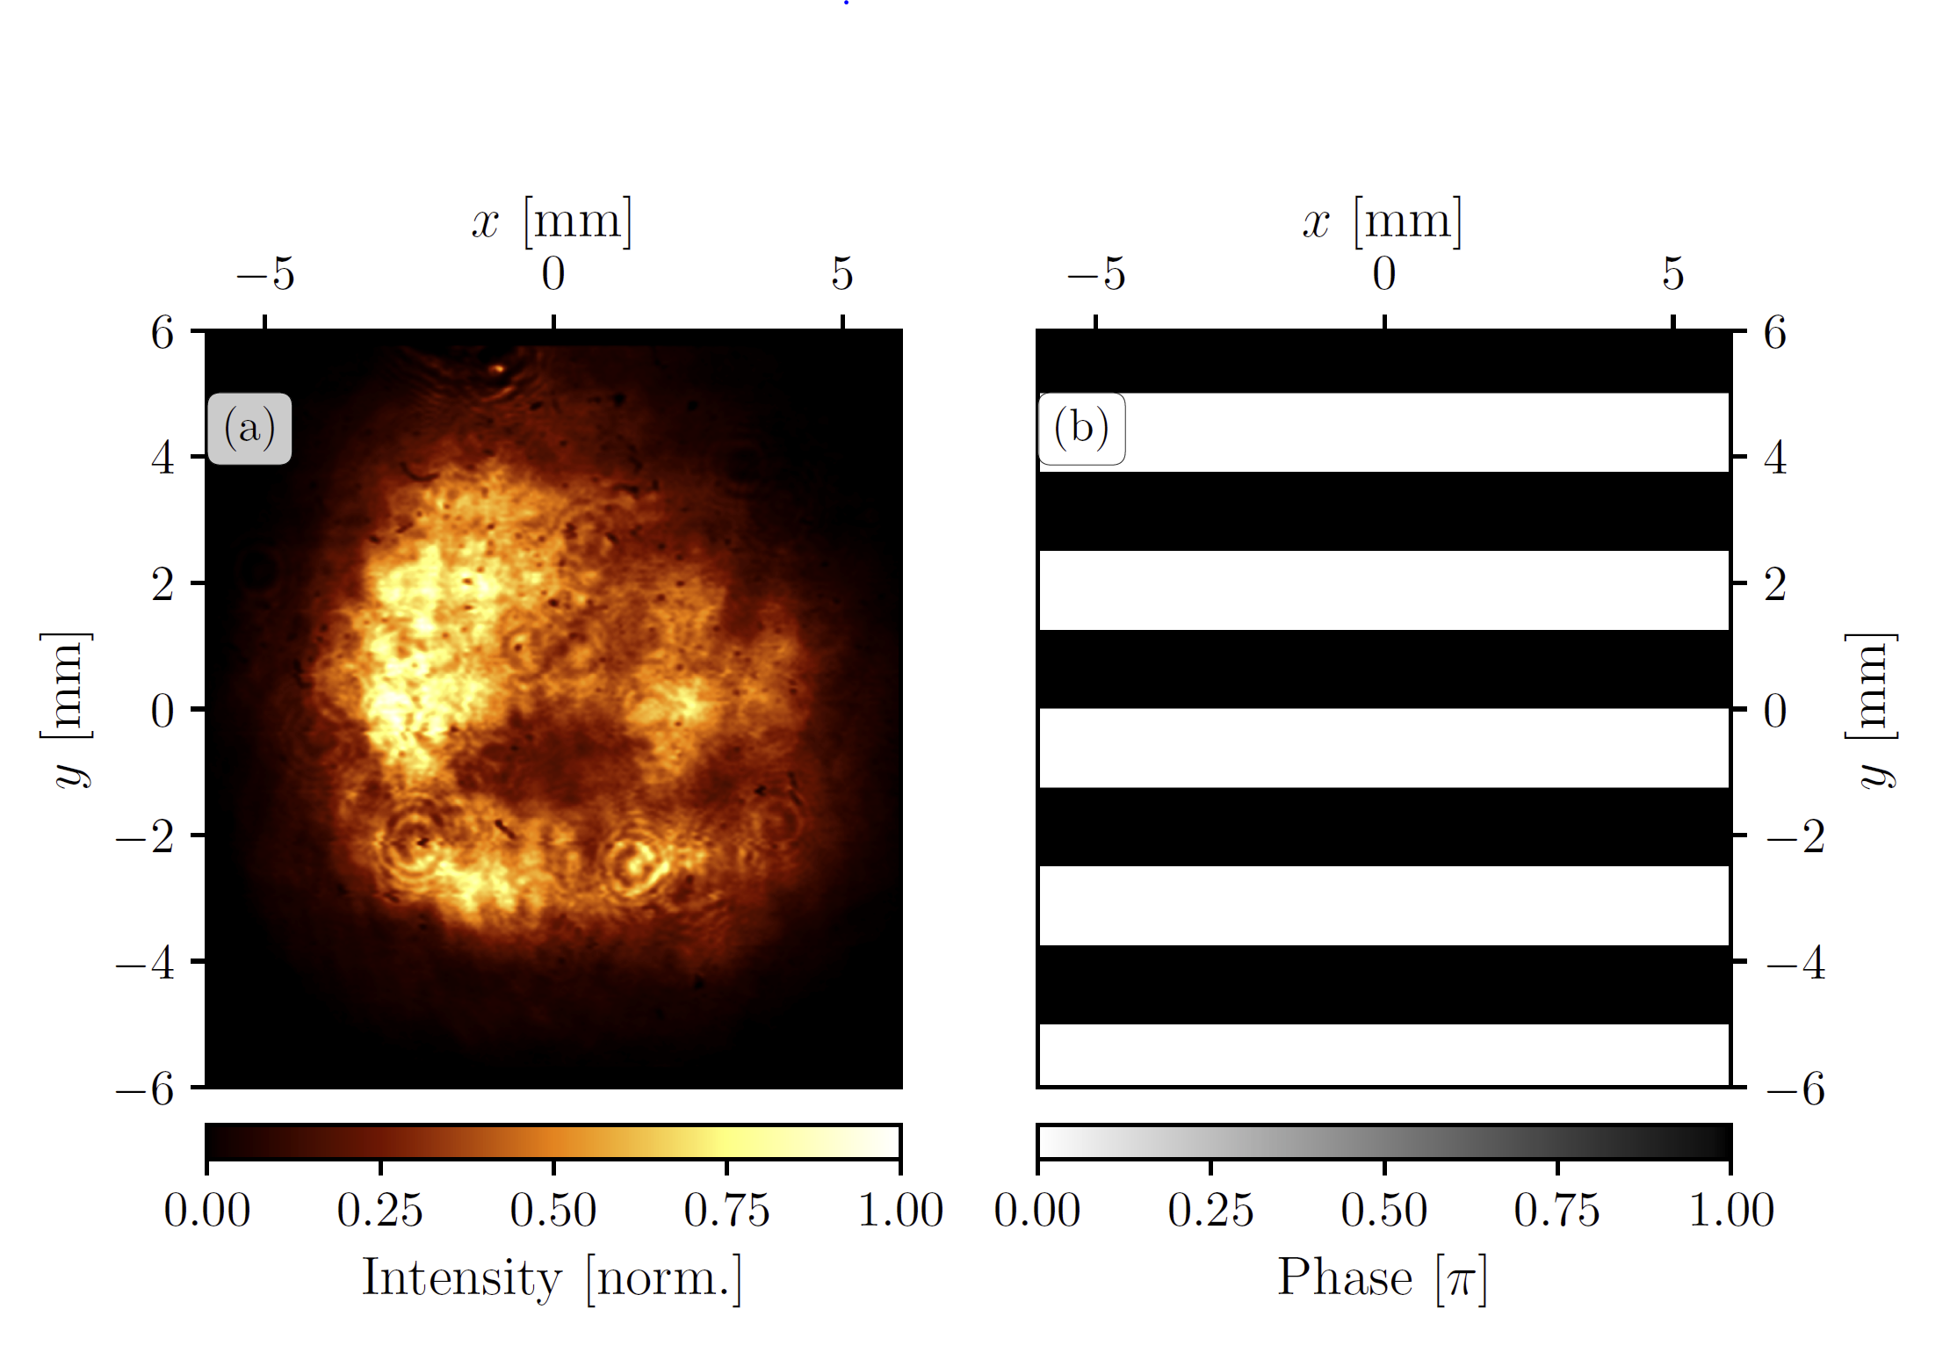
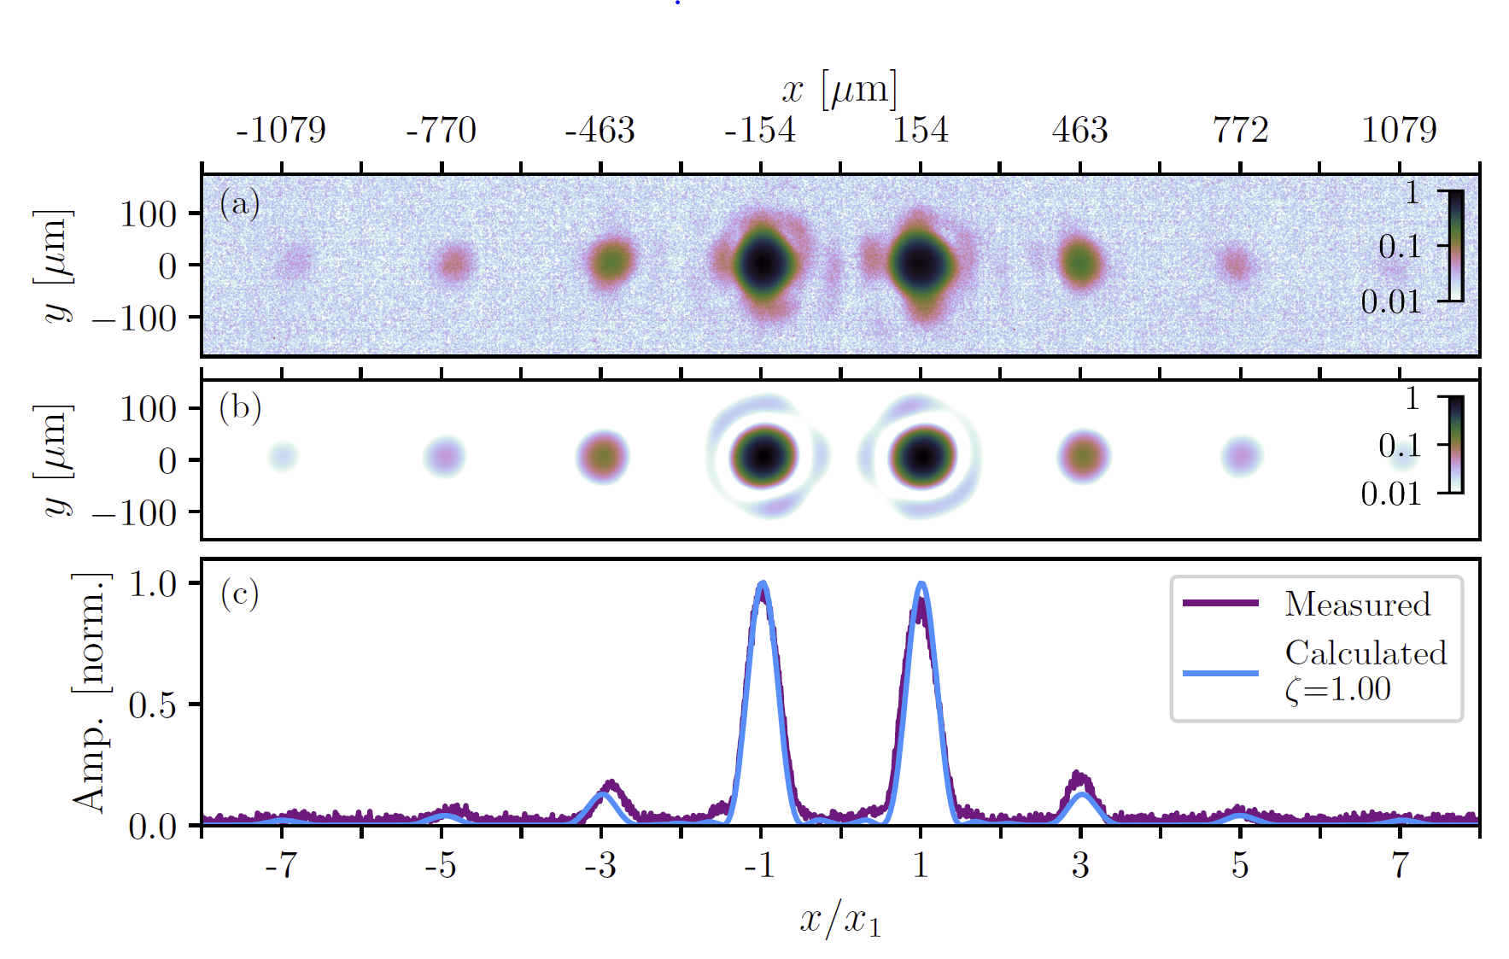

Slide 15
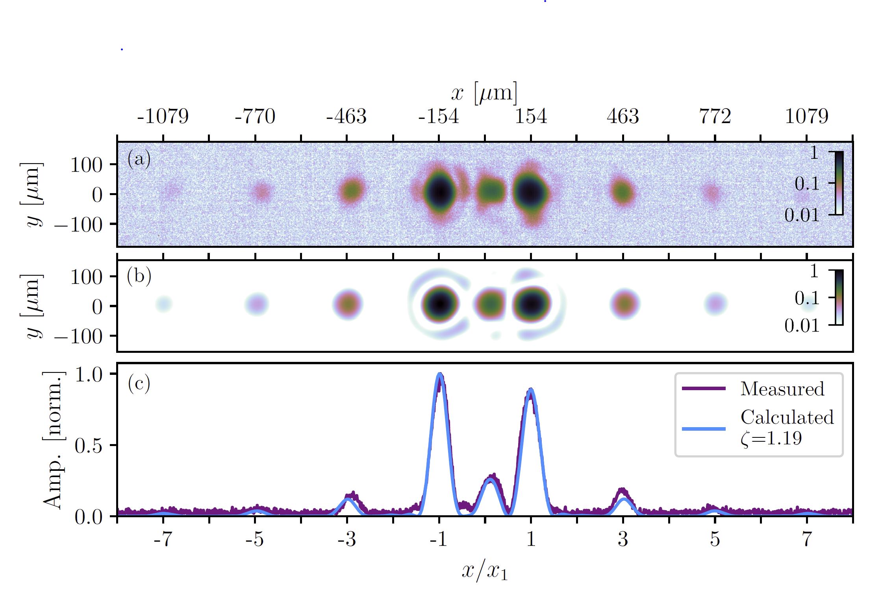

Slide 16
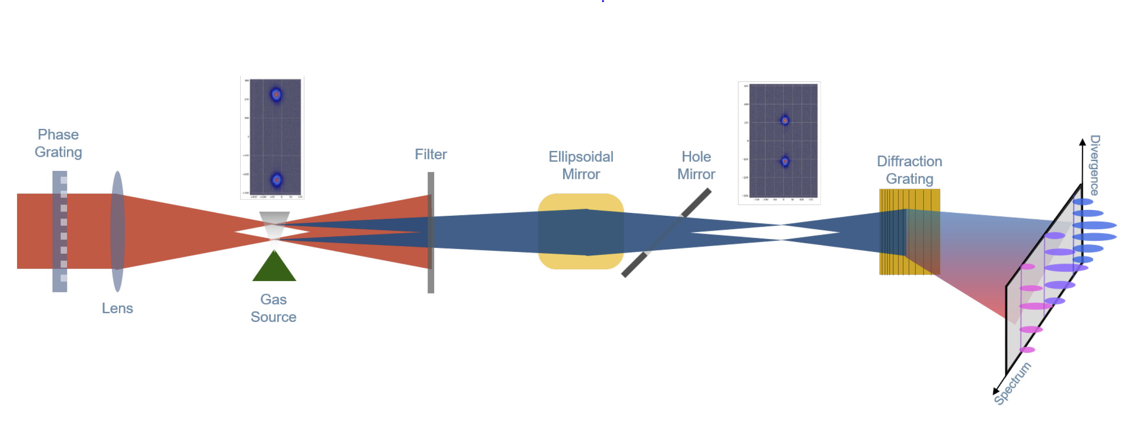
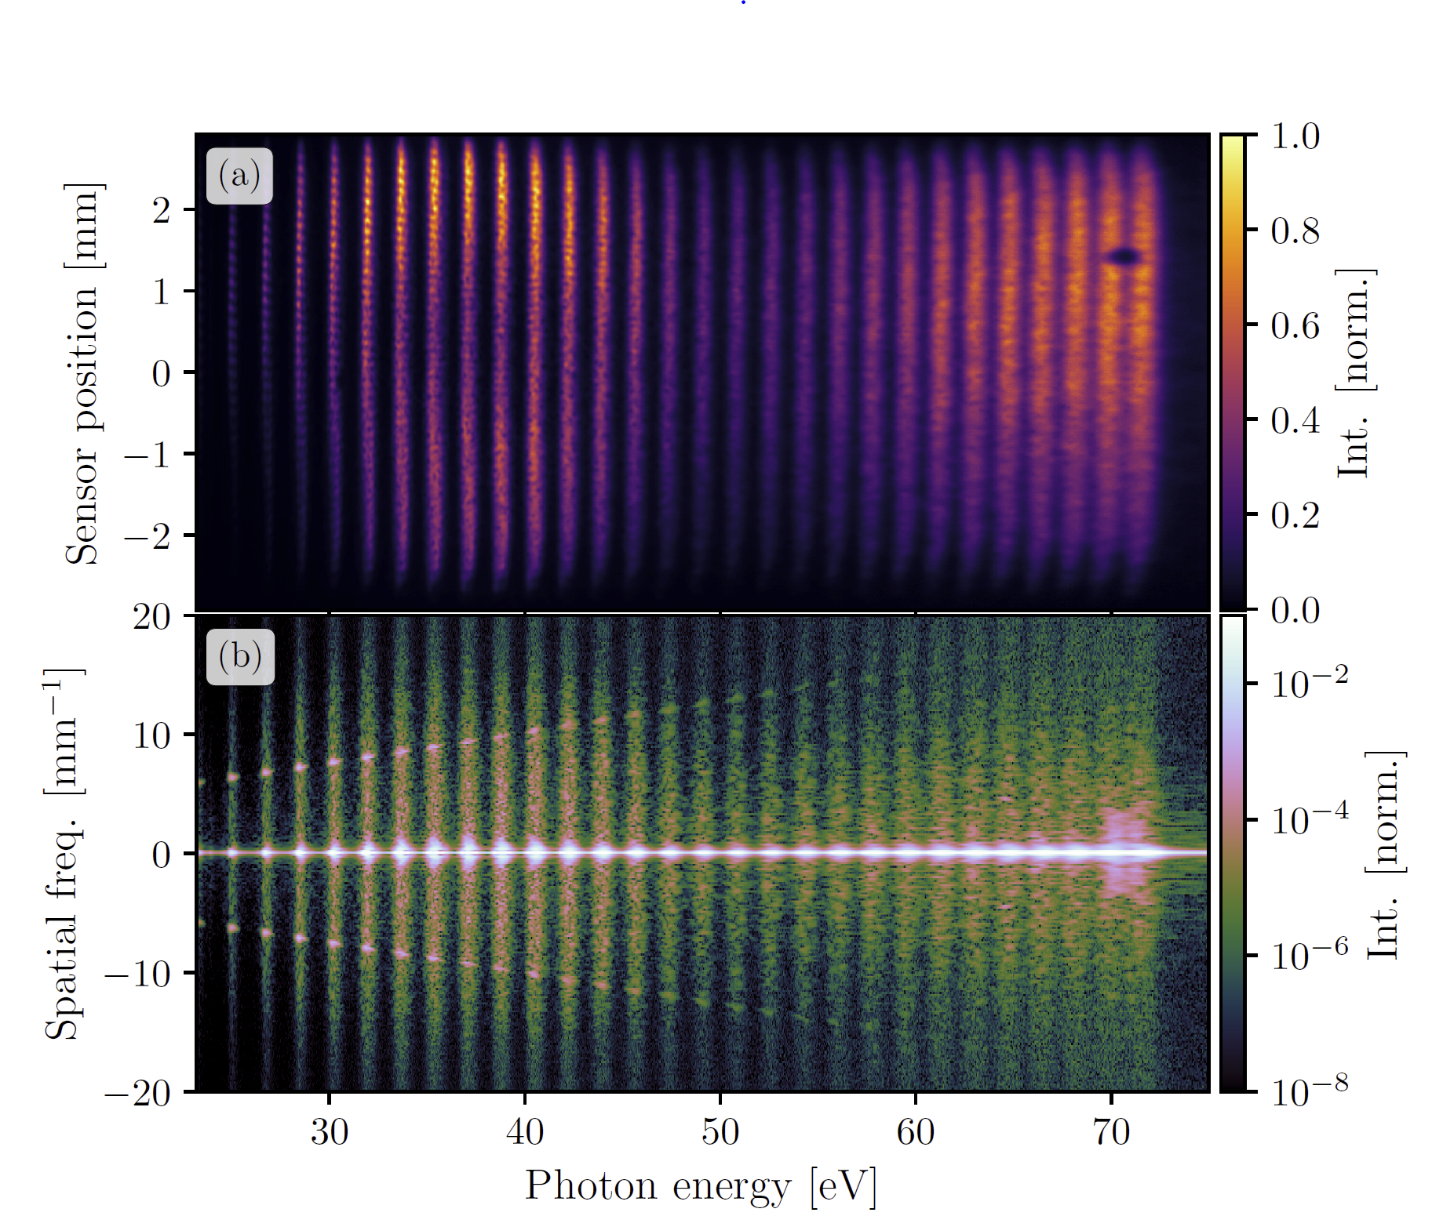
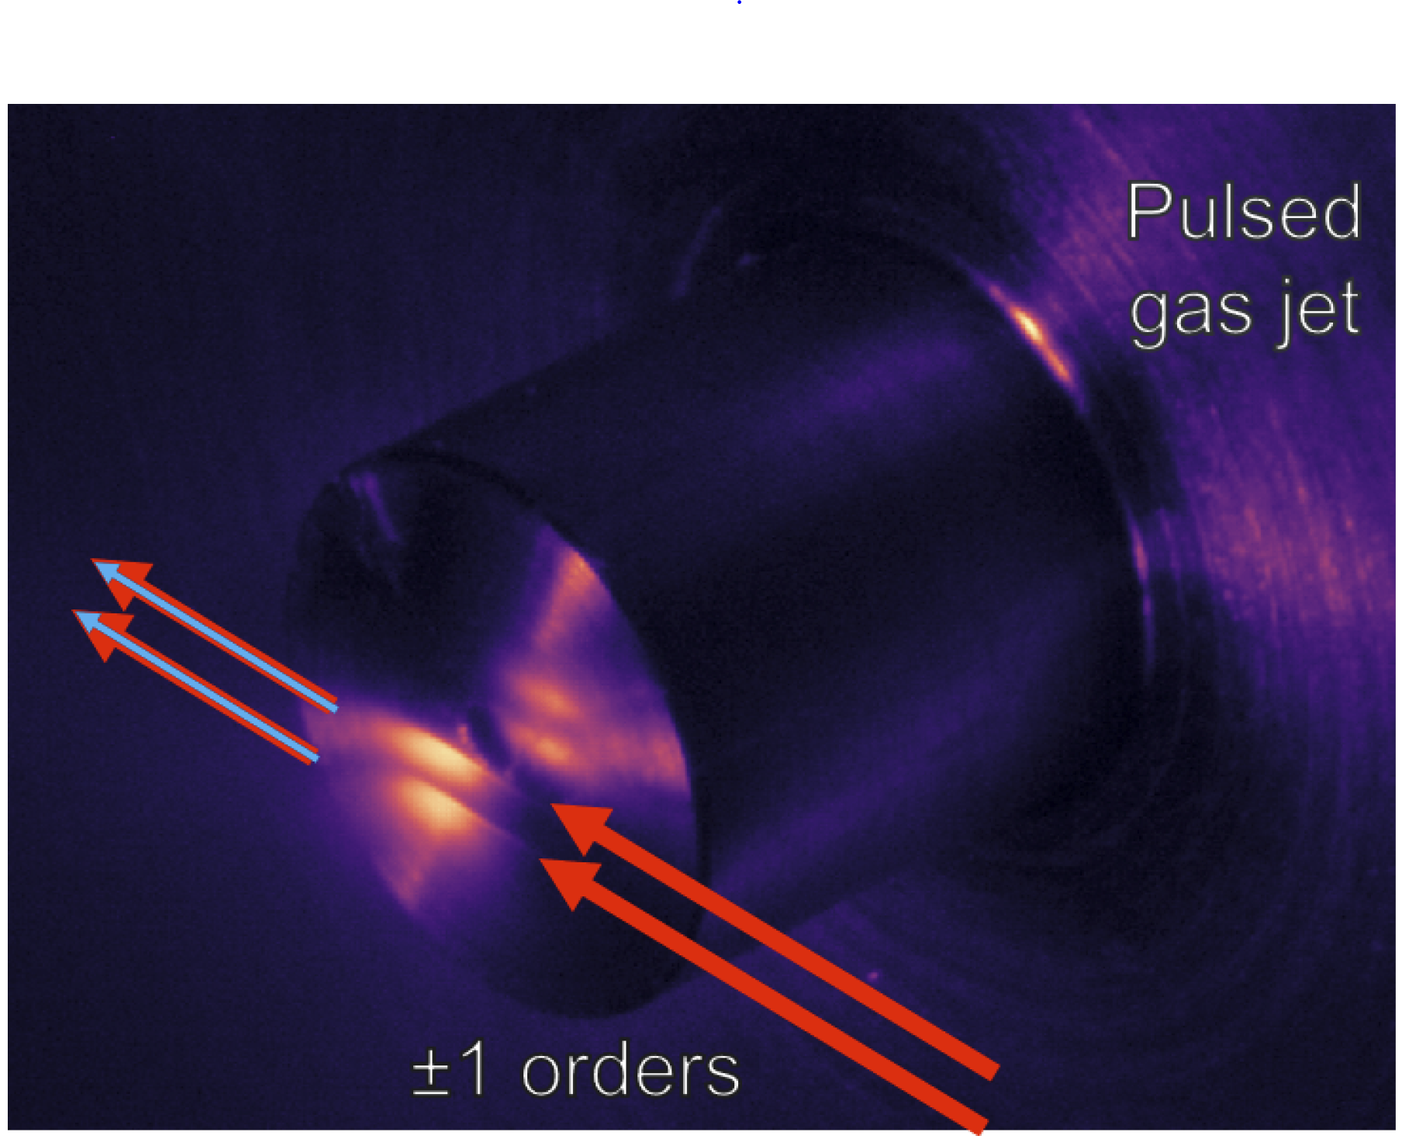

Slide 17
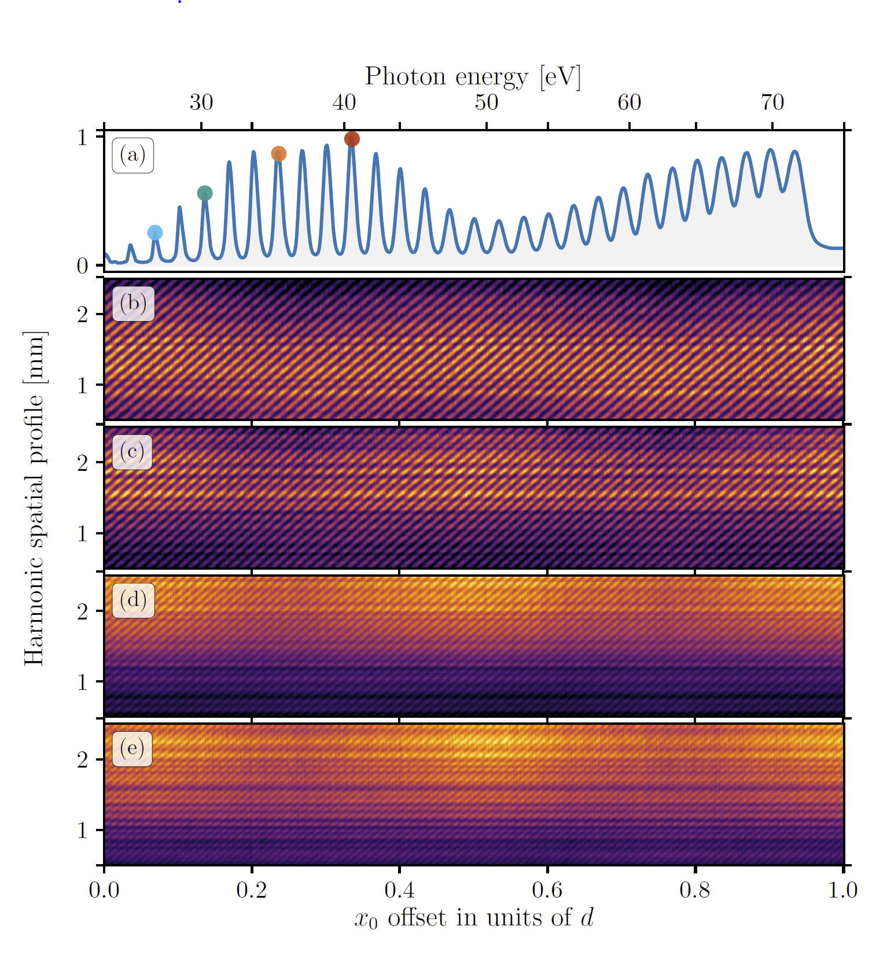
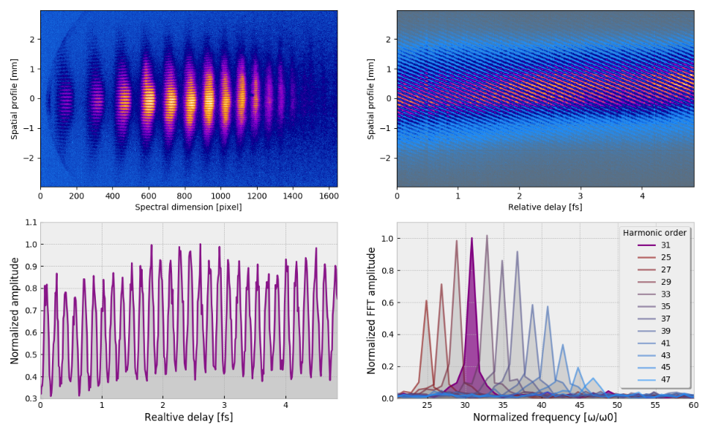
H31
H31
H31

Slide 18
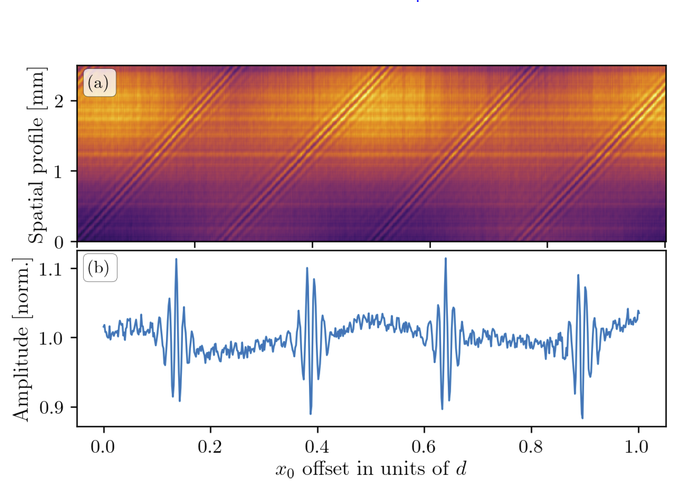
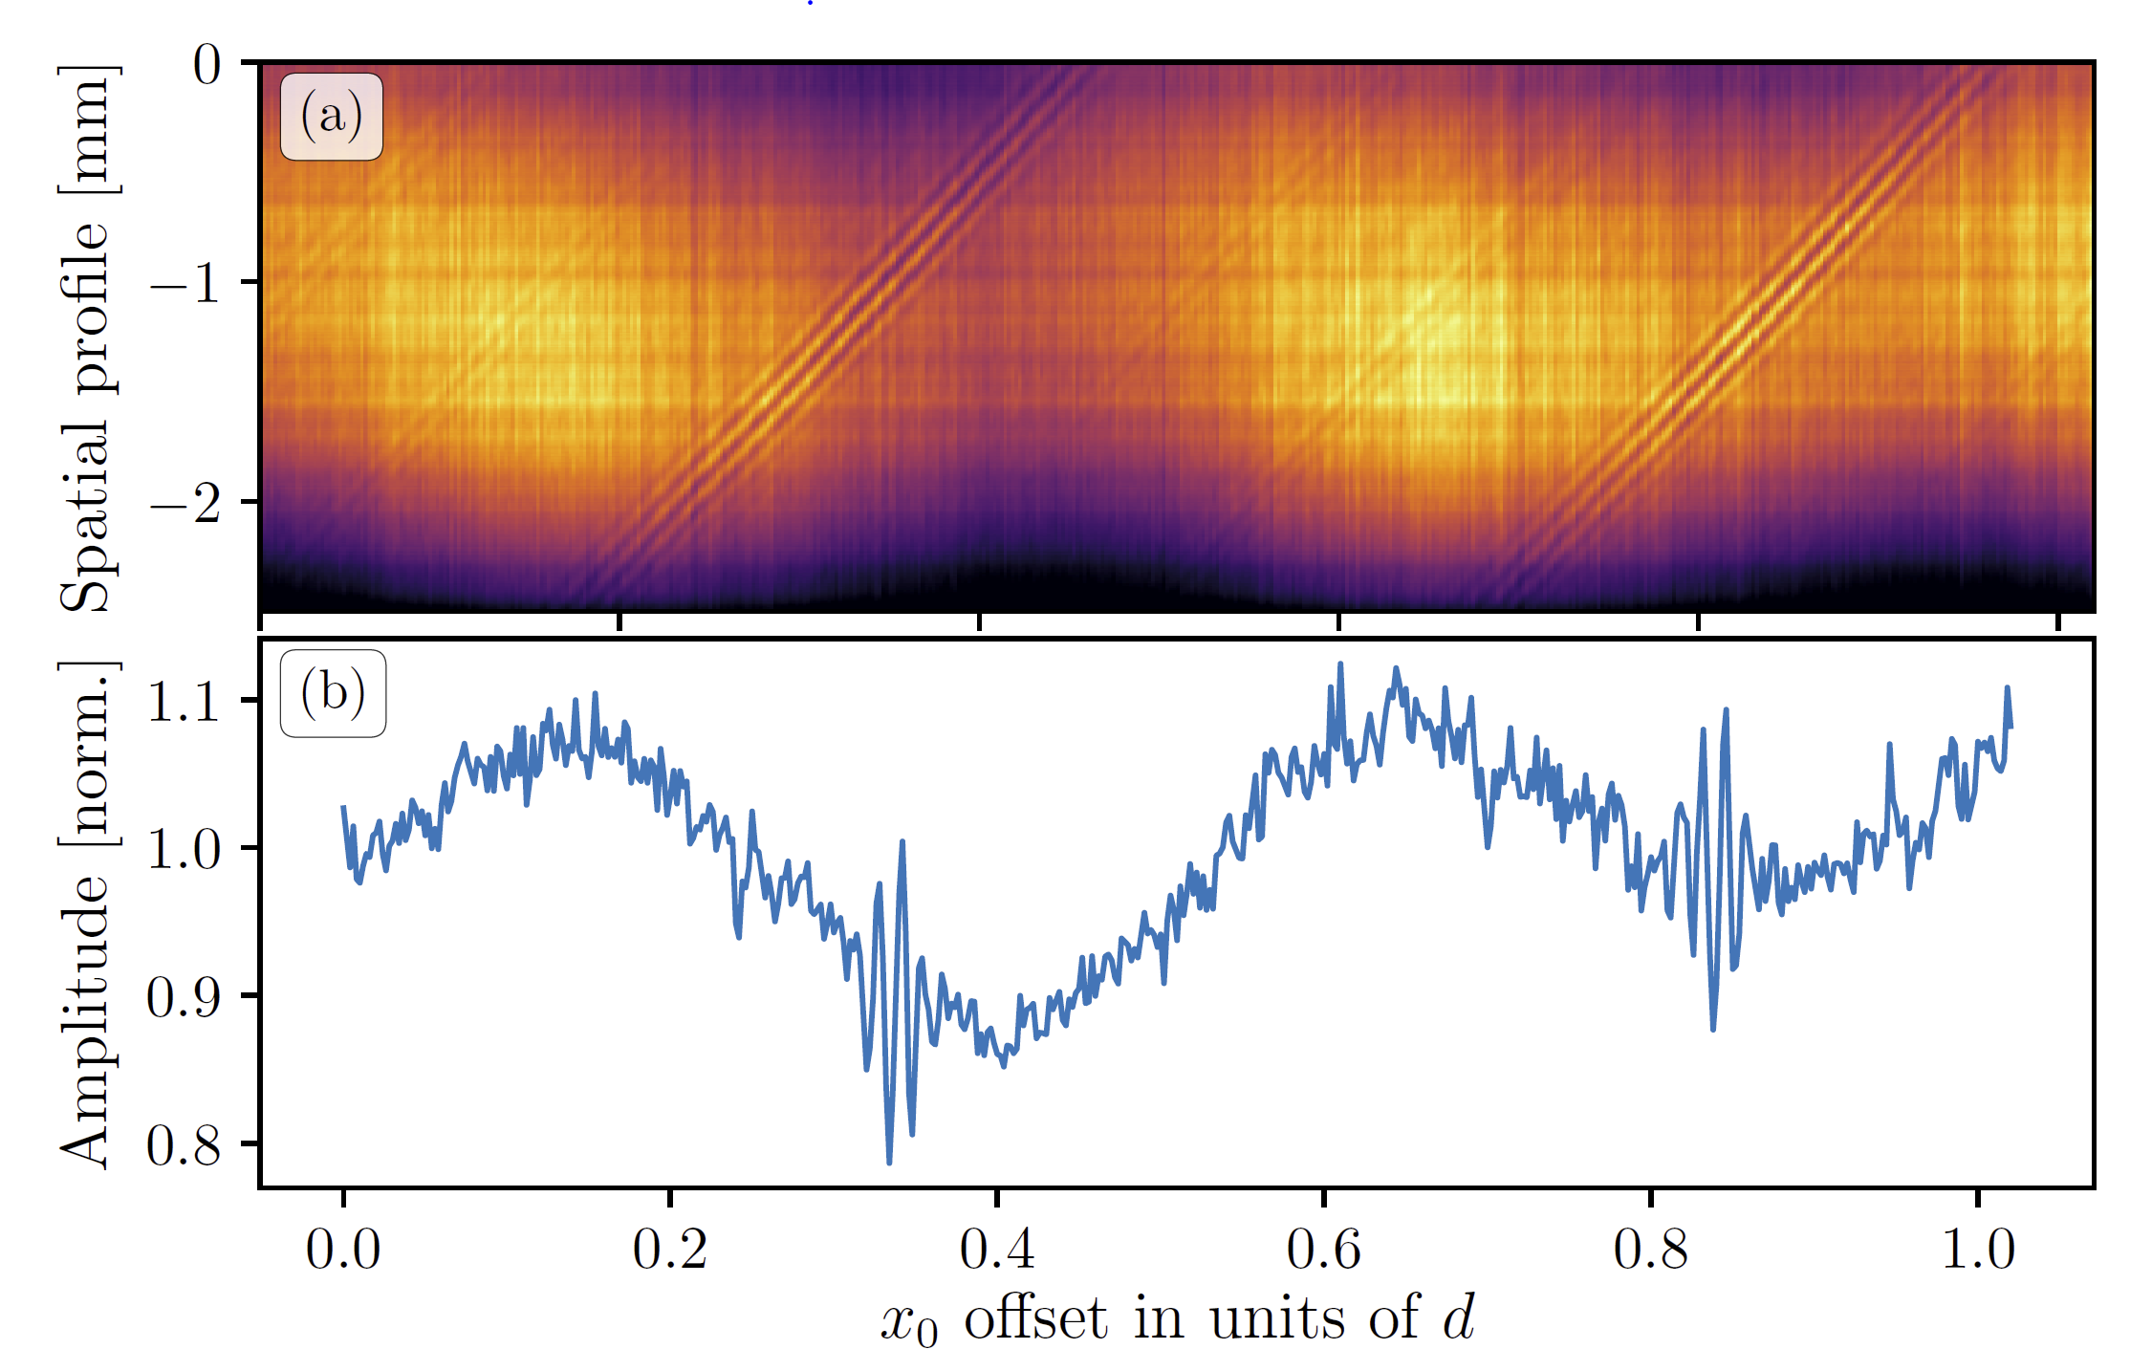

Slide 19
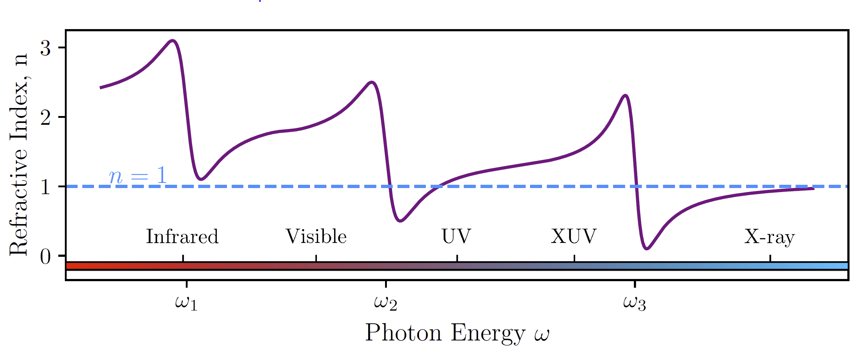

Slide 20
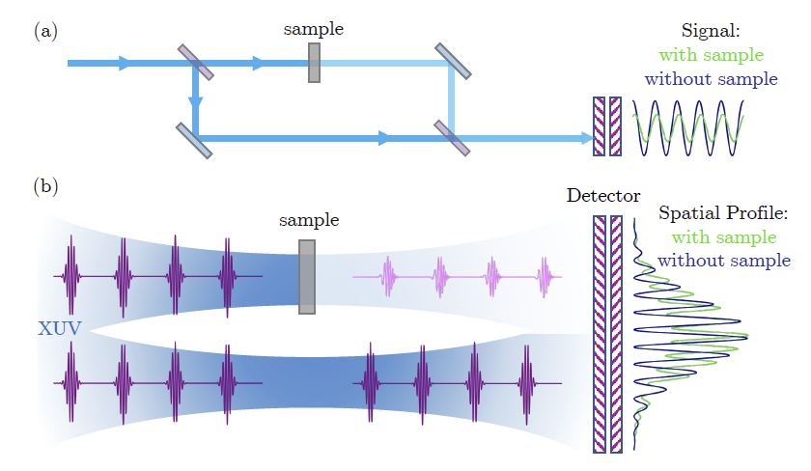
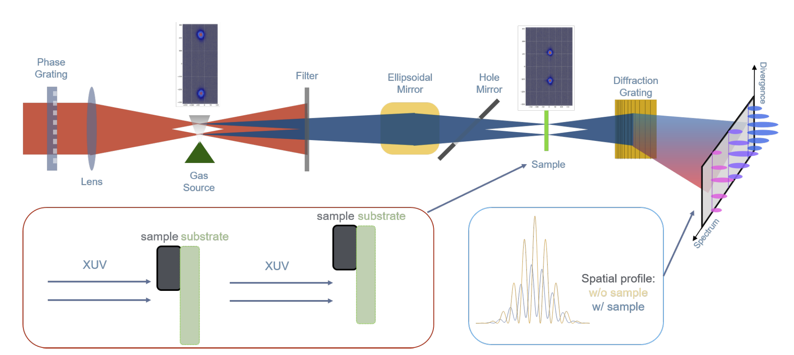

Slide 21
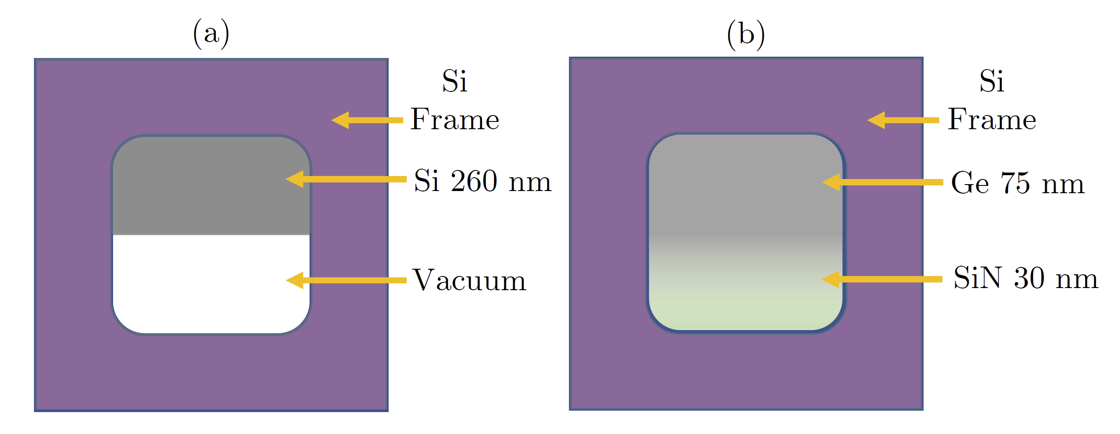
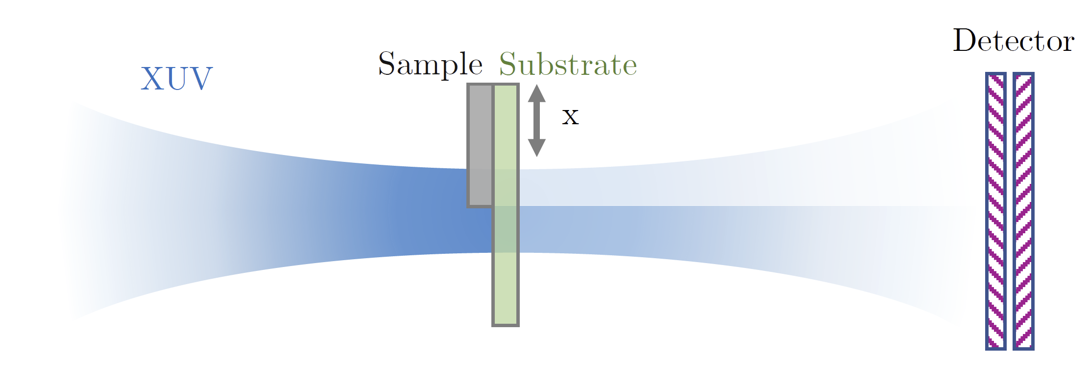
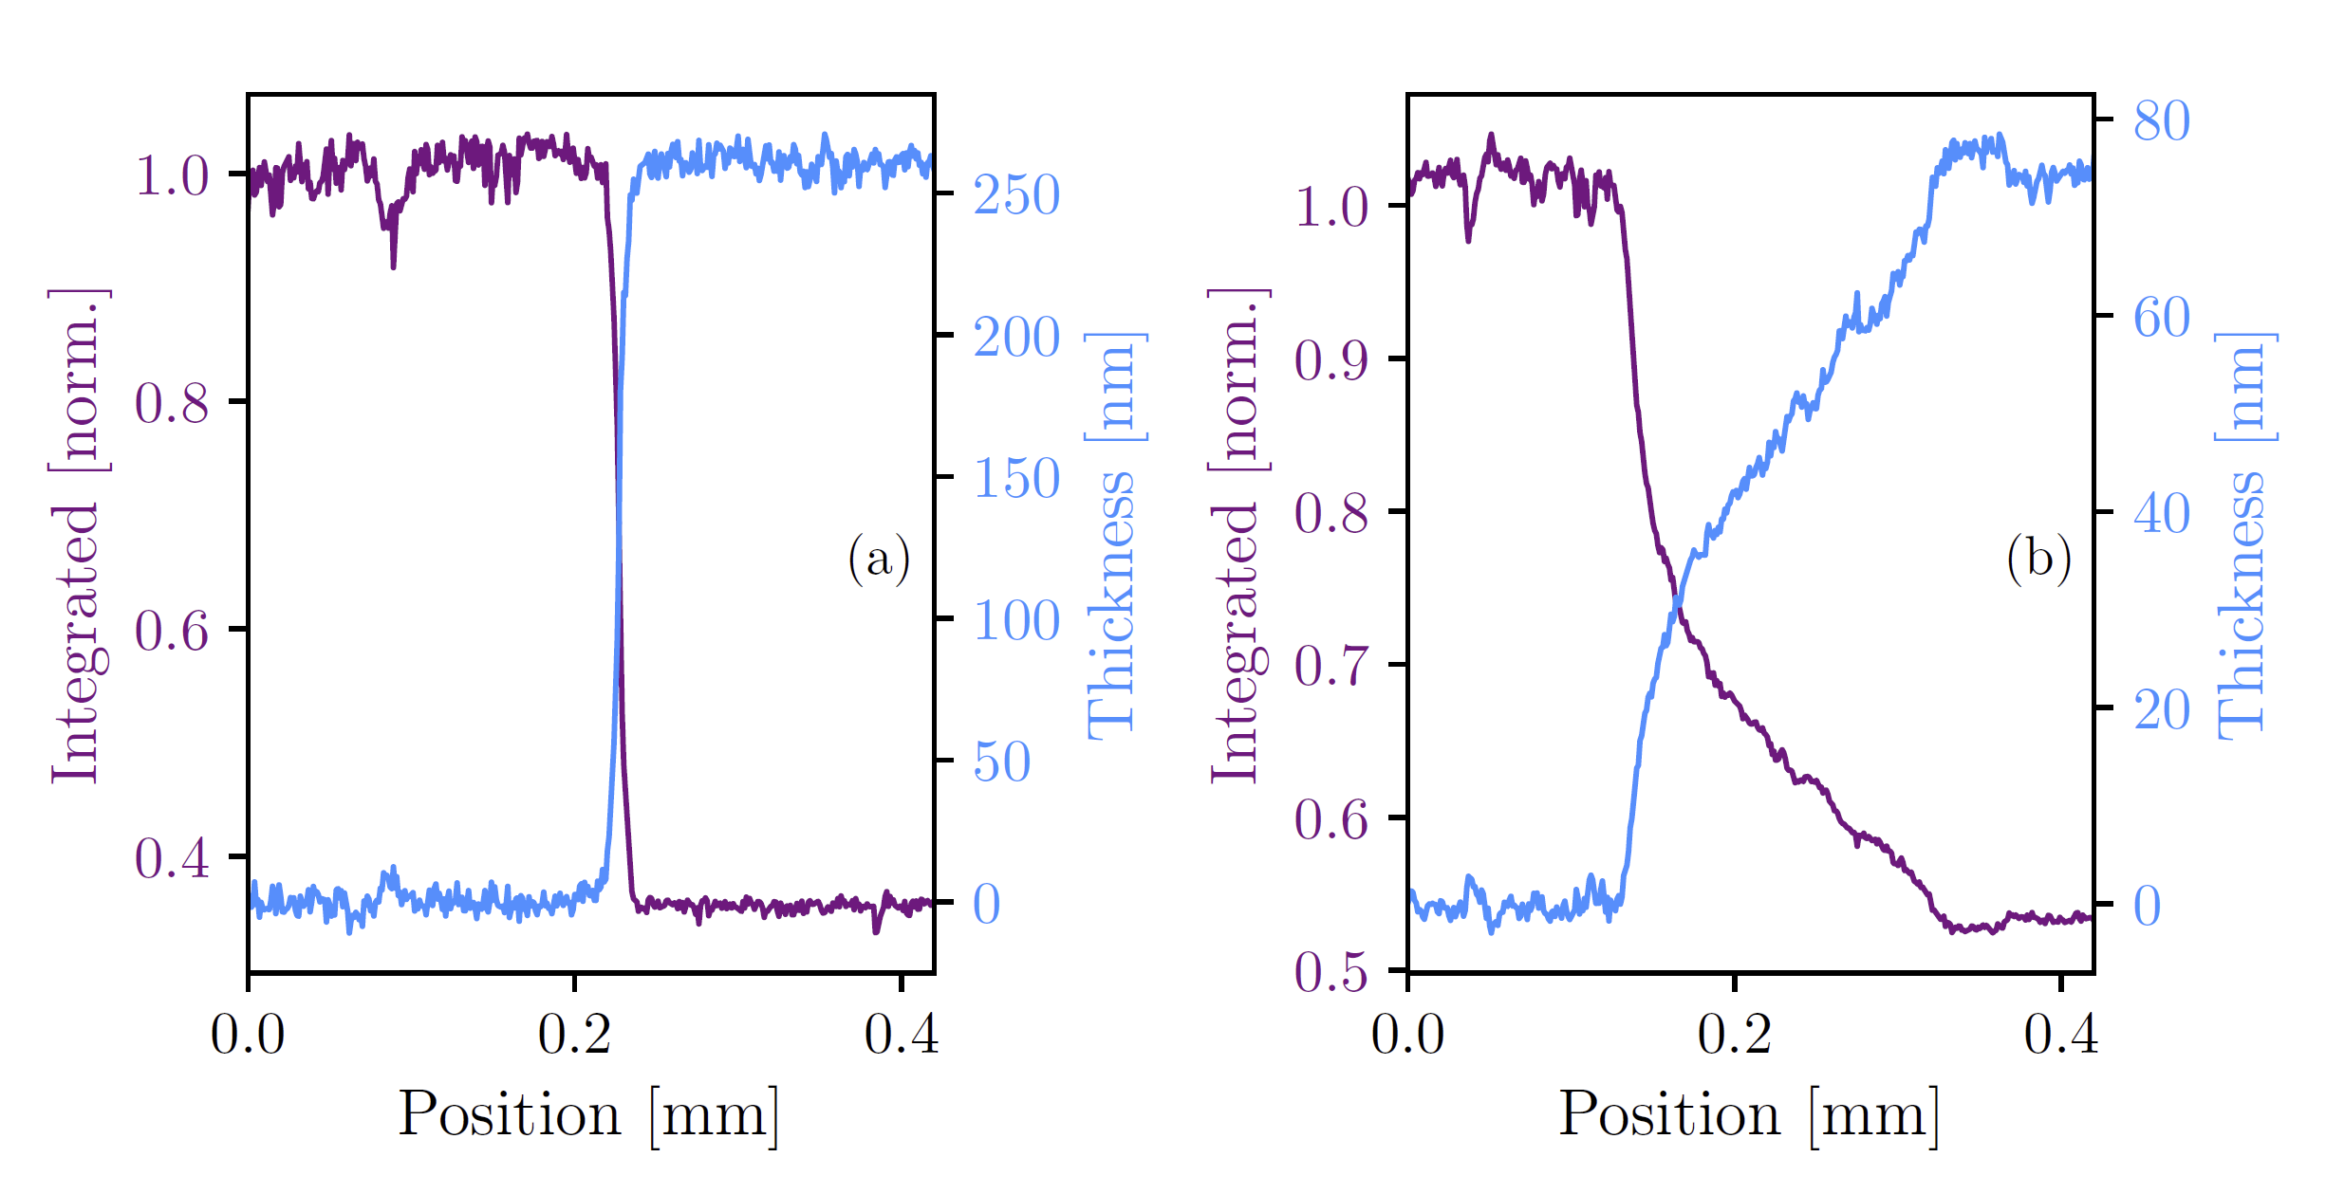

Slide 22
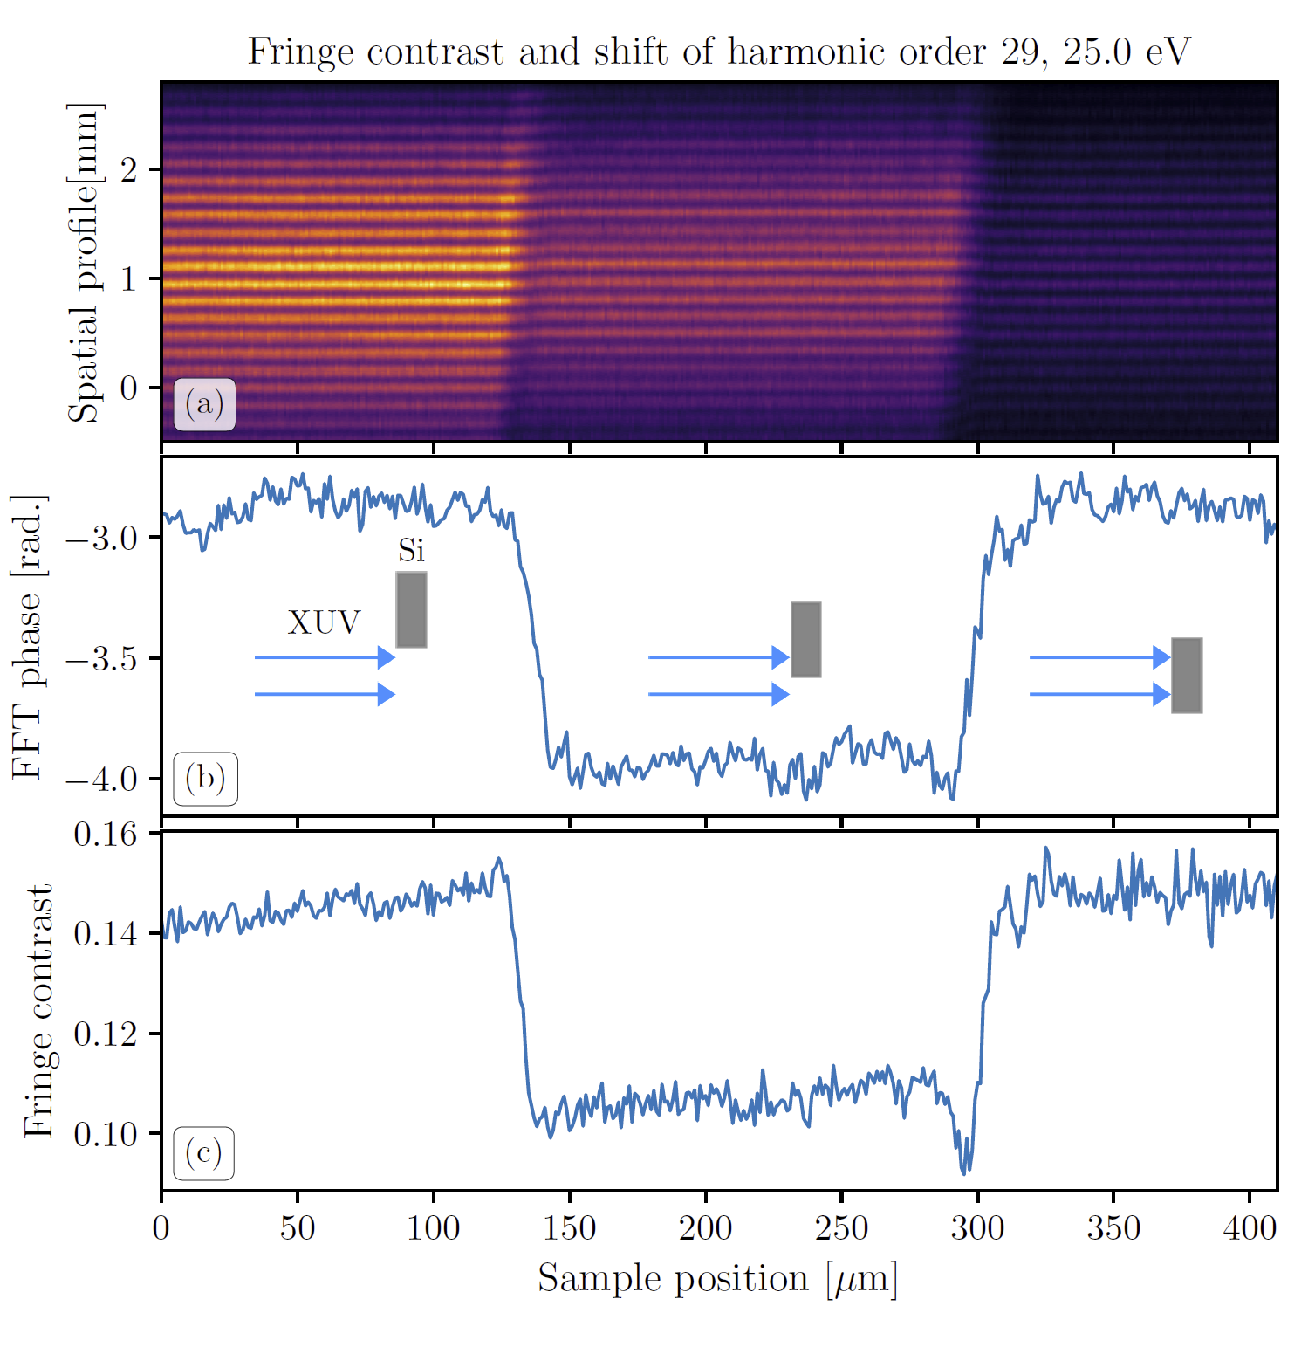
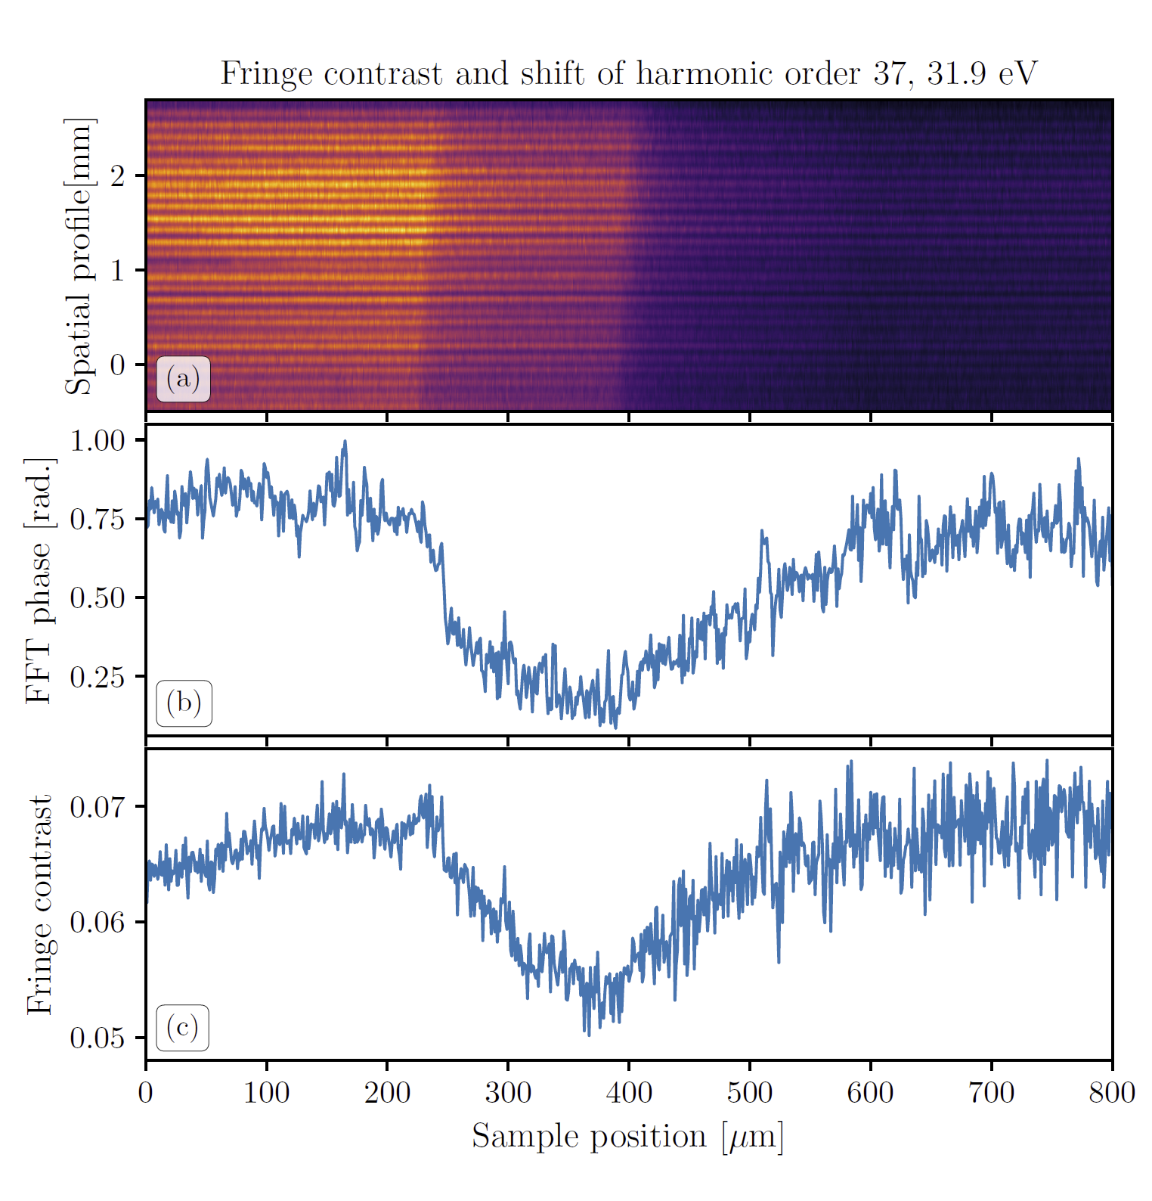

Slide 23
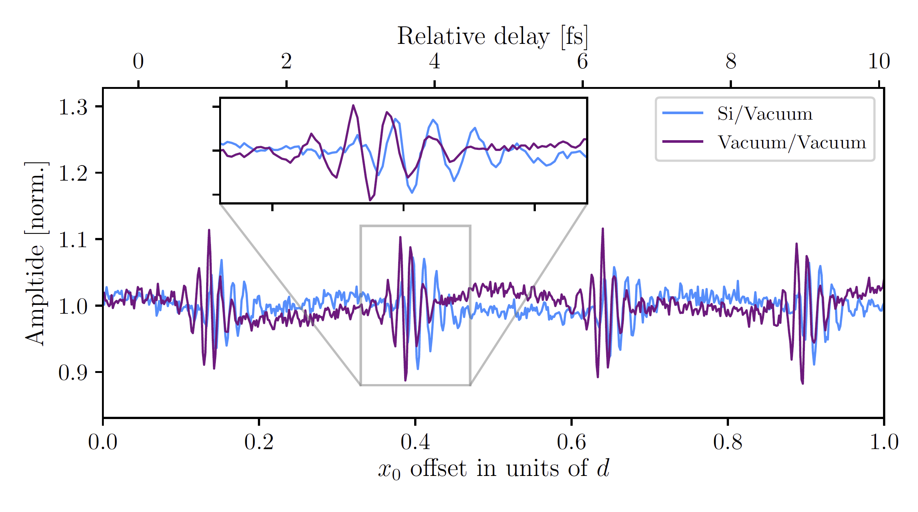
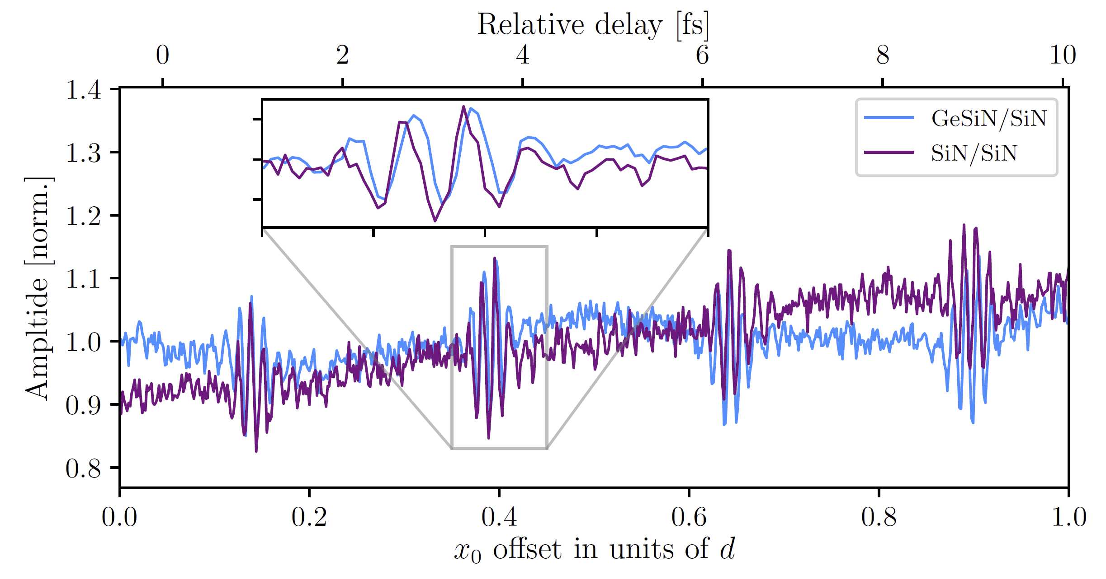

Slide 24
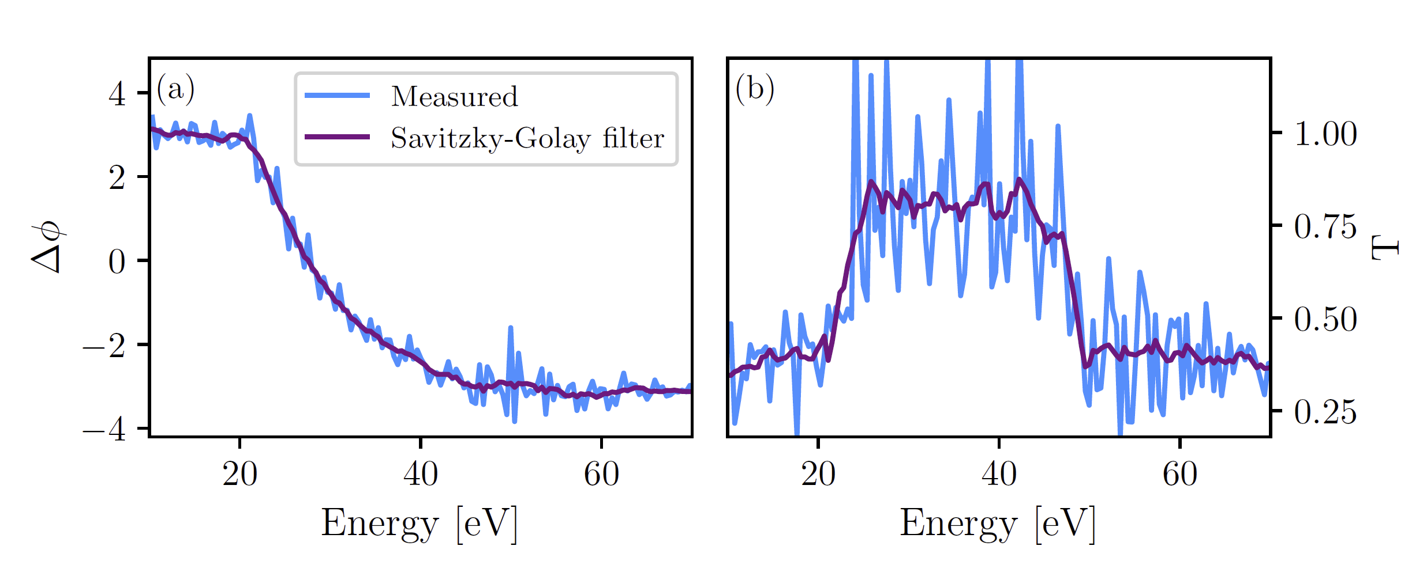
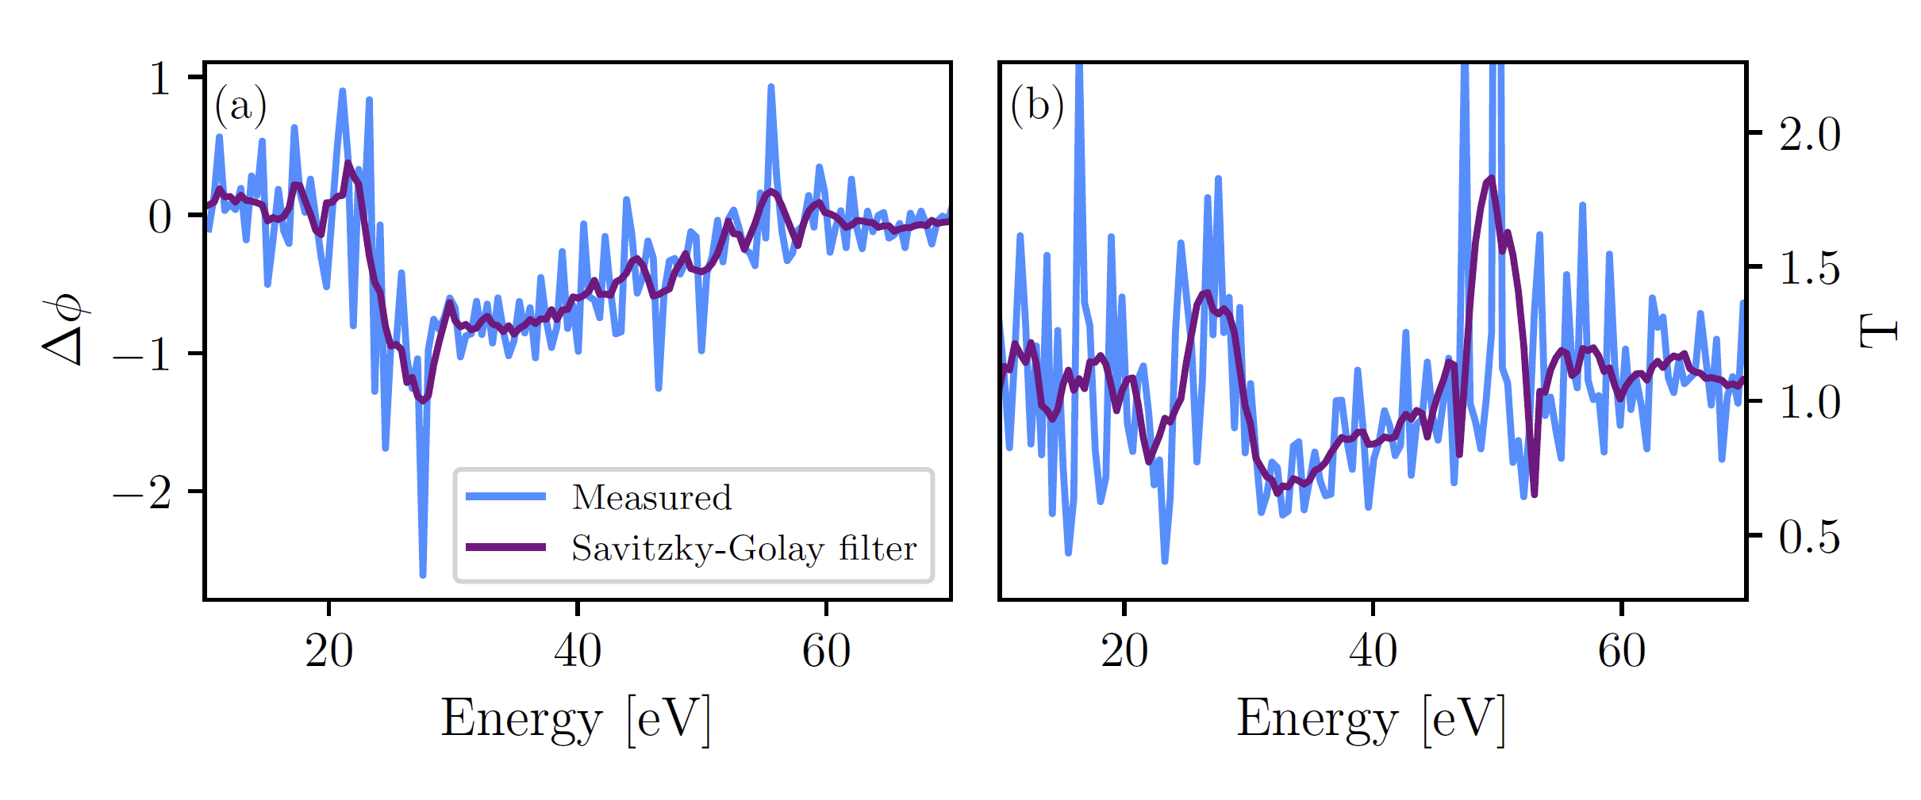

Slide 25
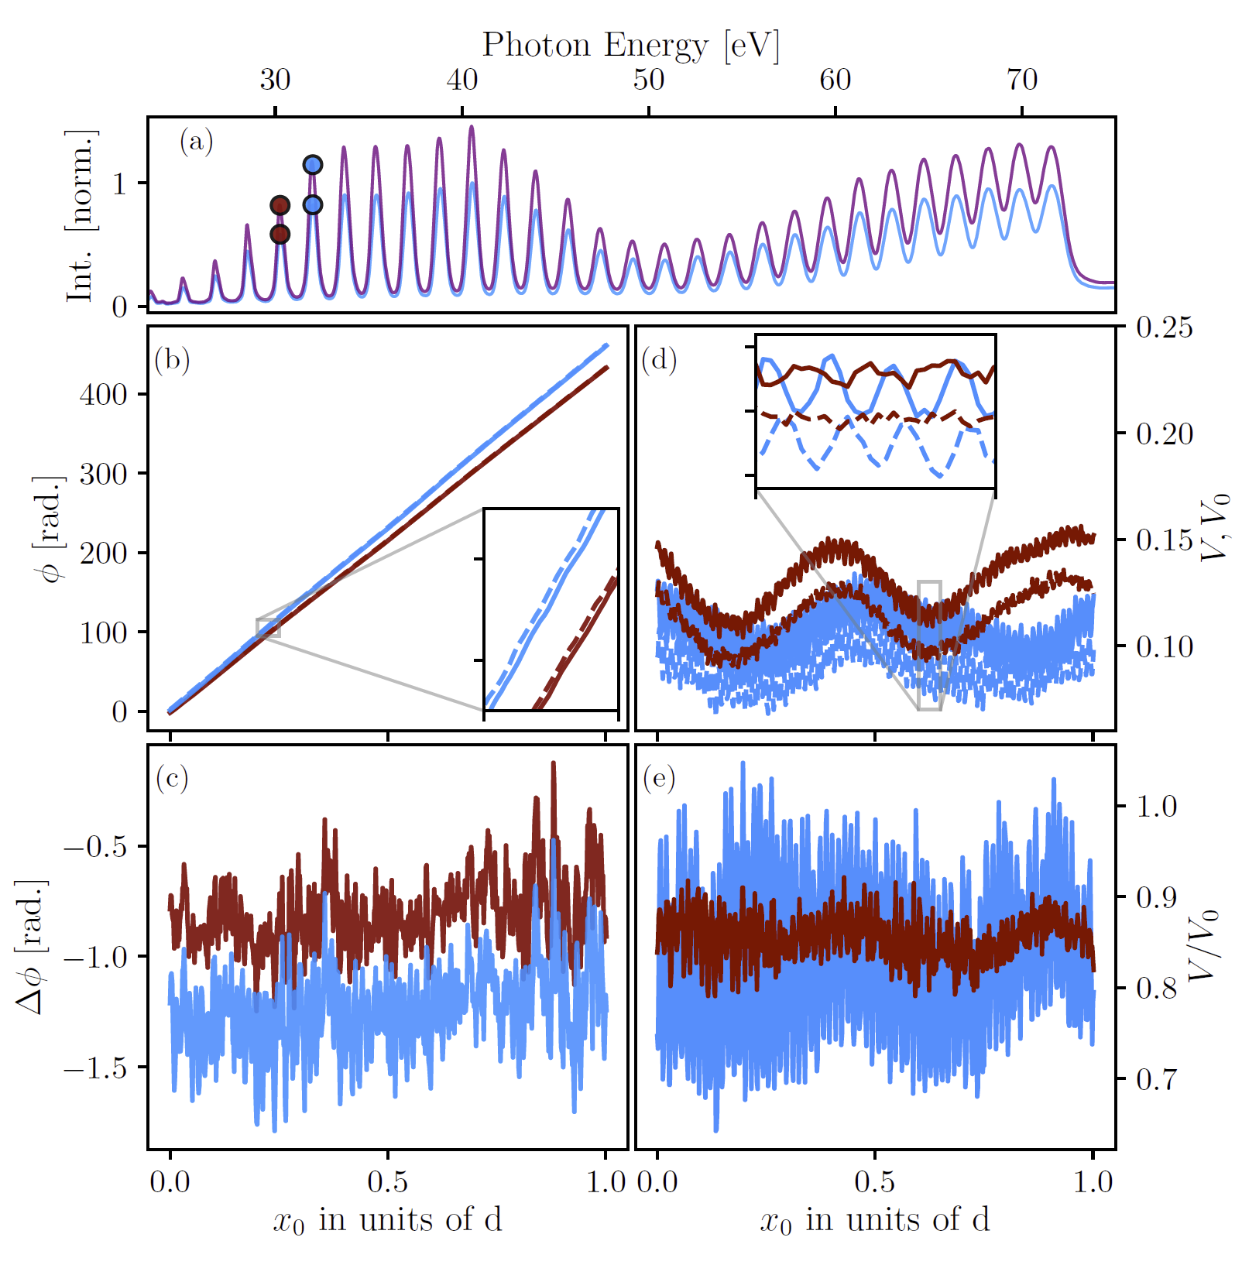

Slide 26
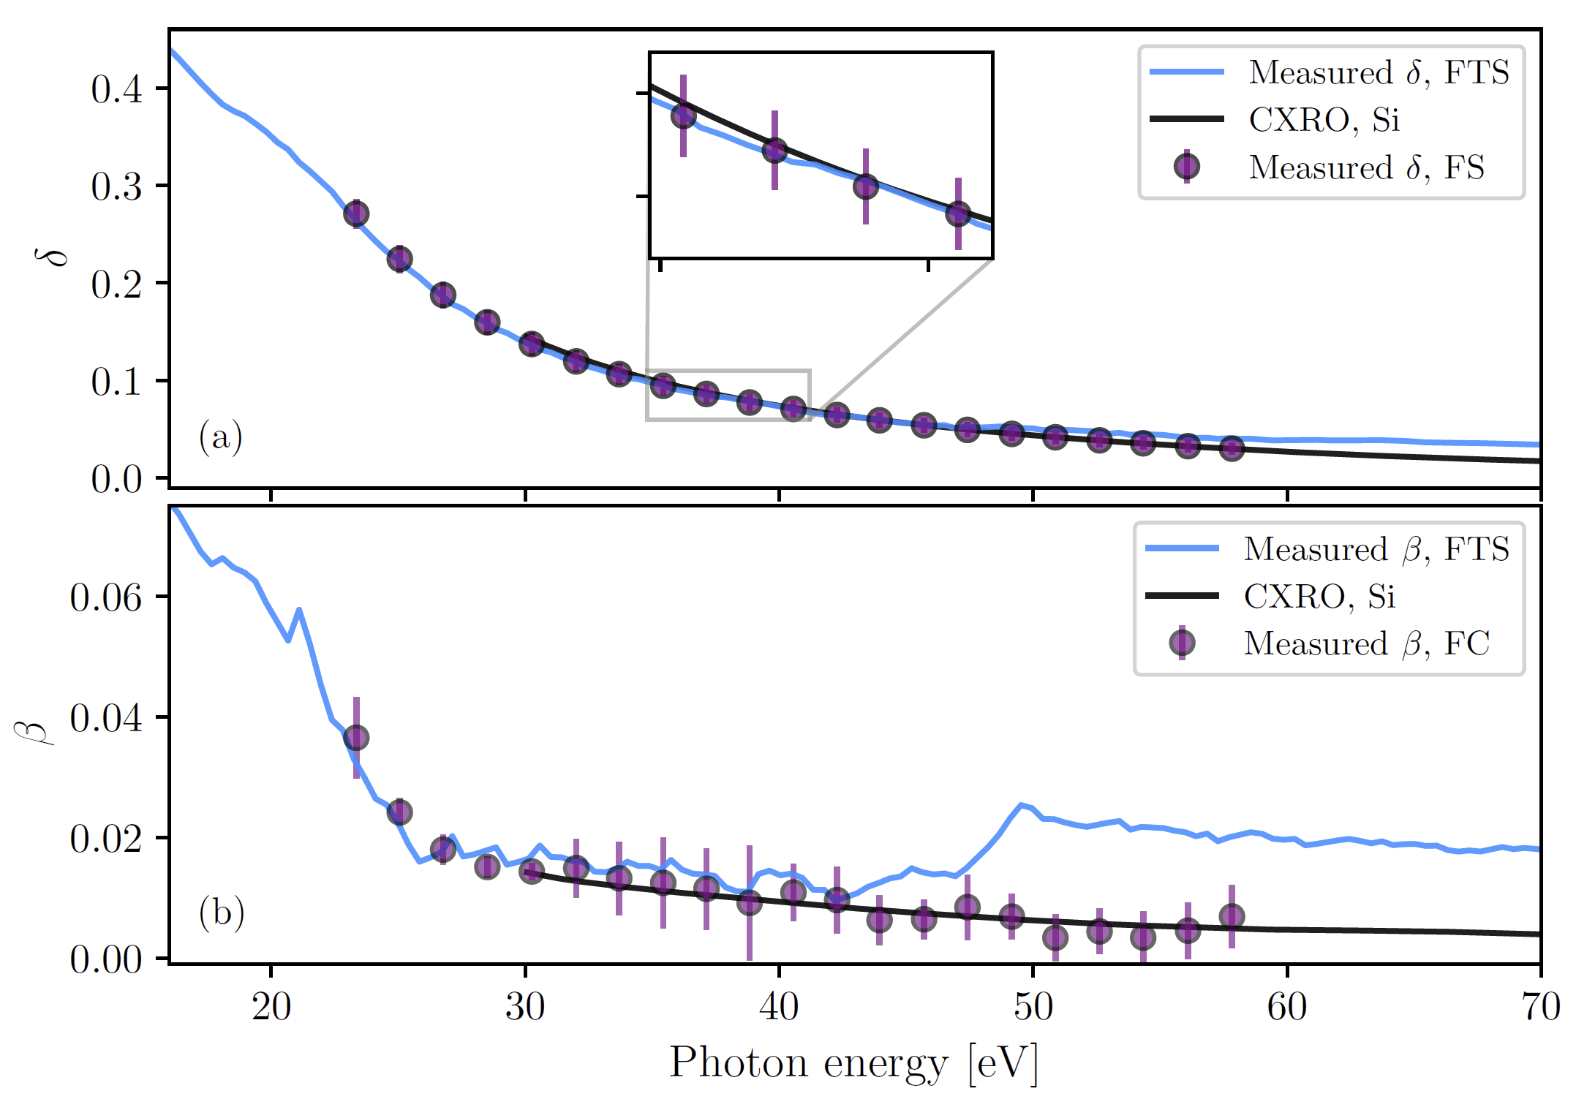
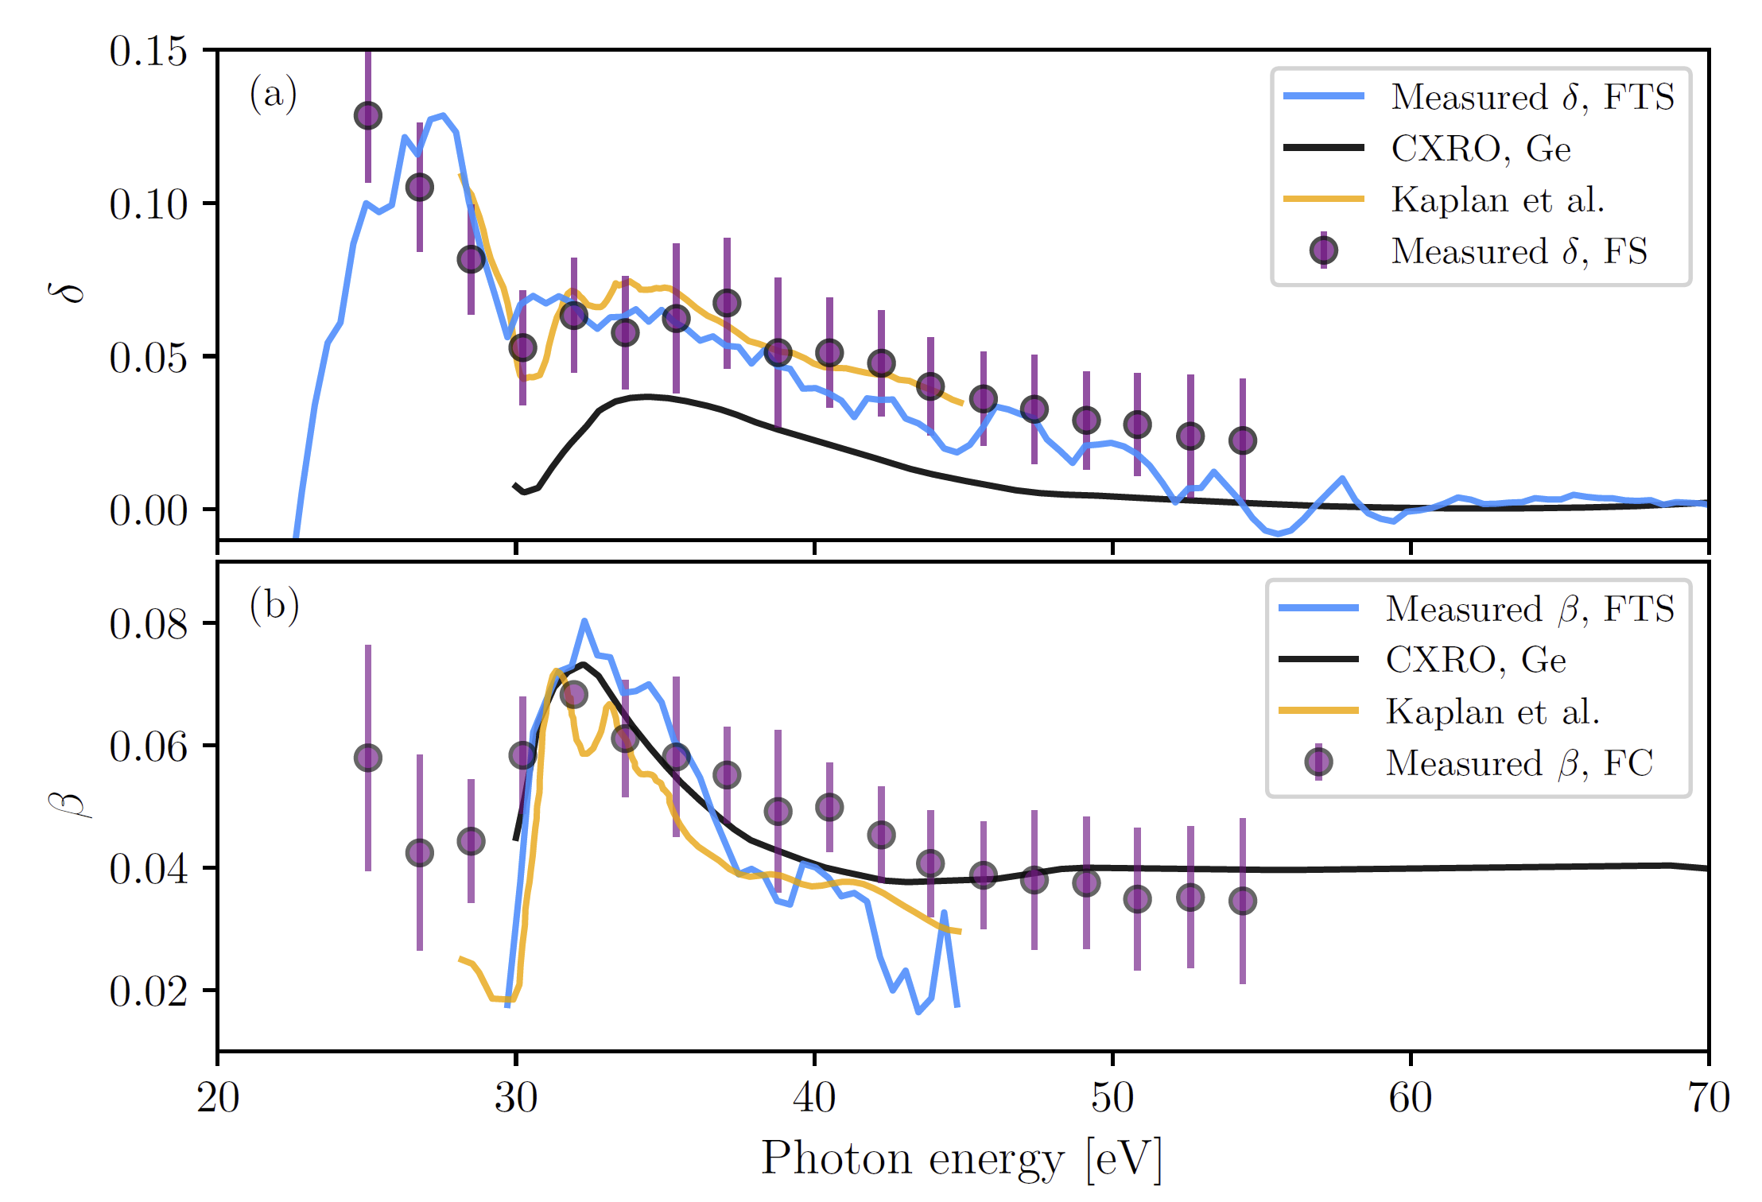

Slide 27
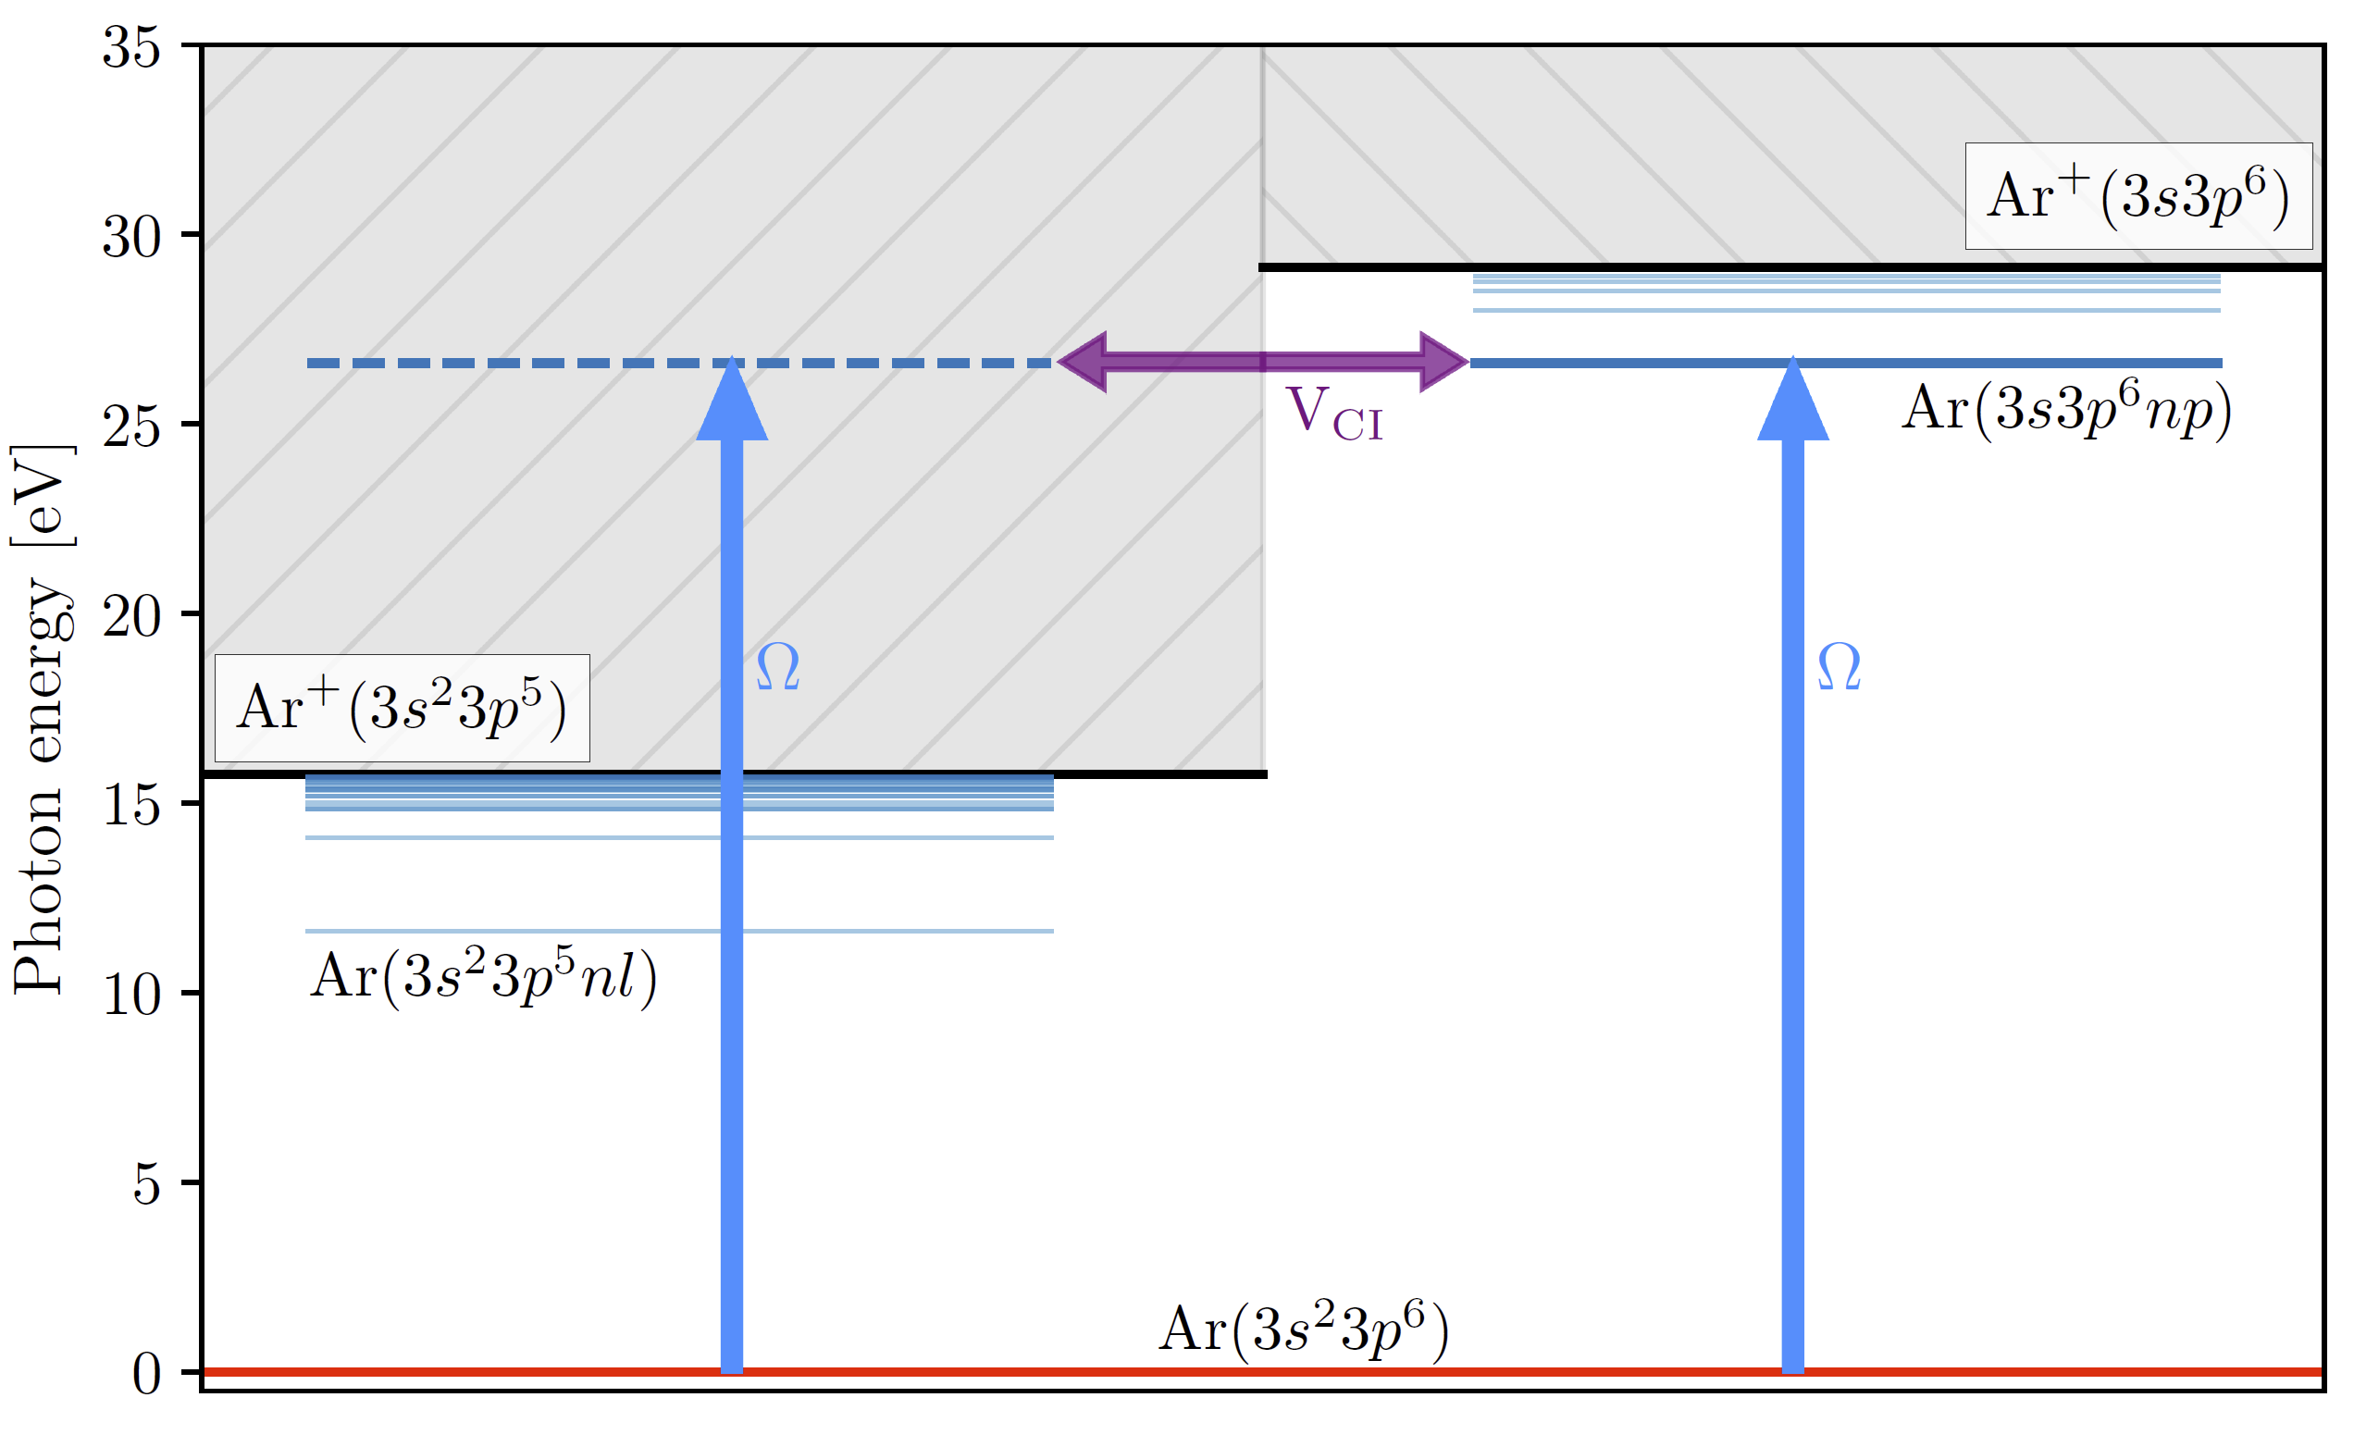
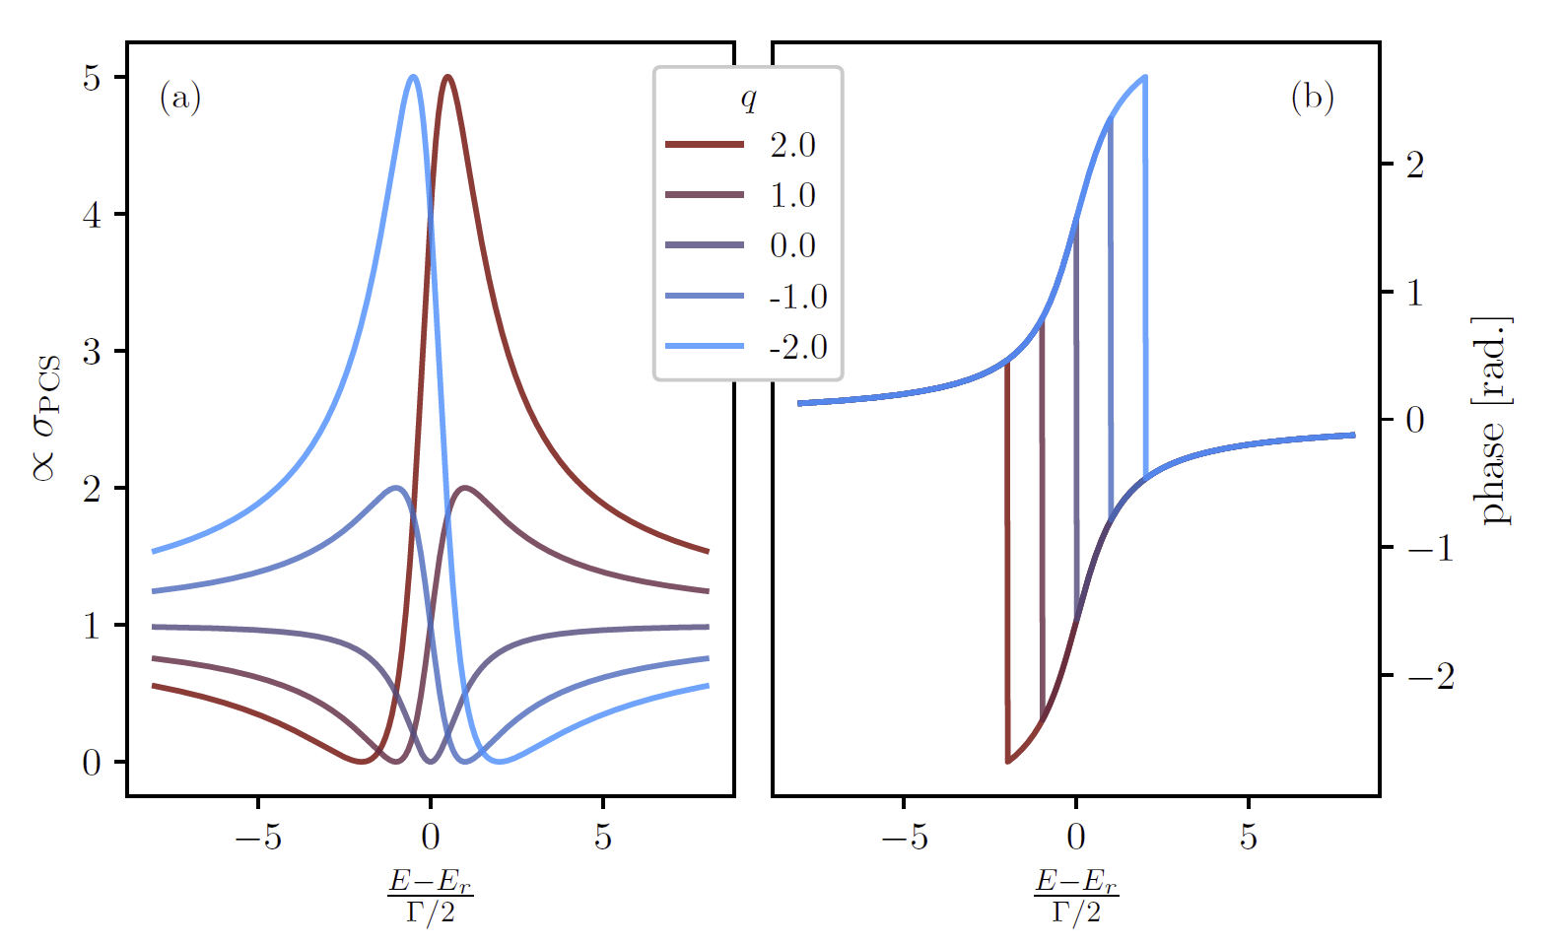

Slide 28
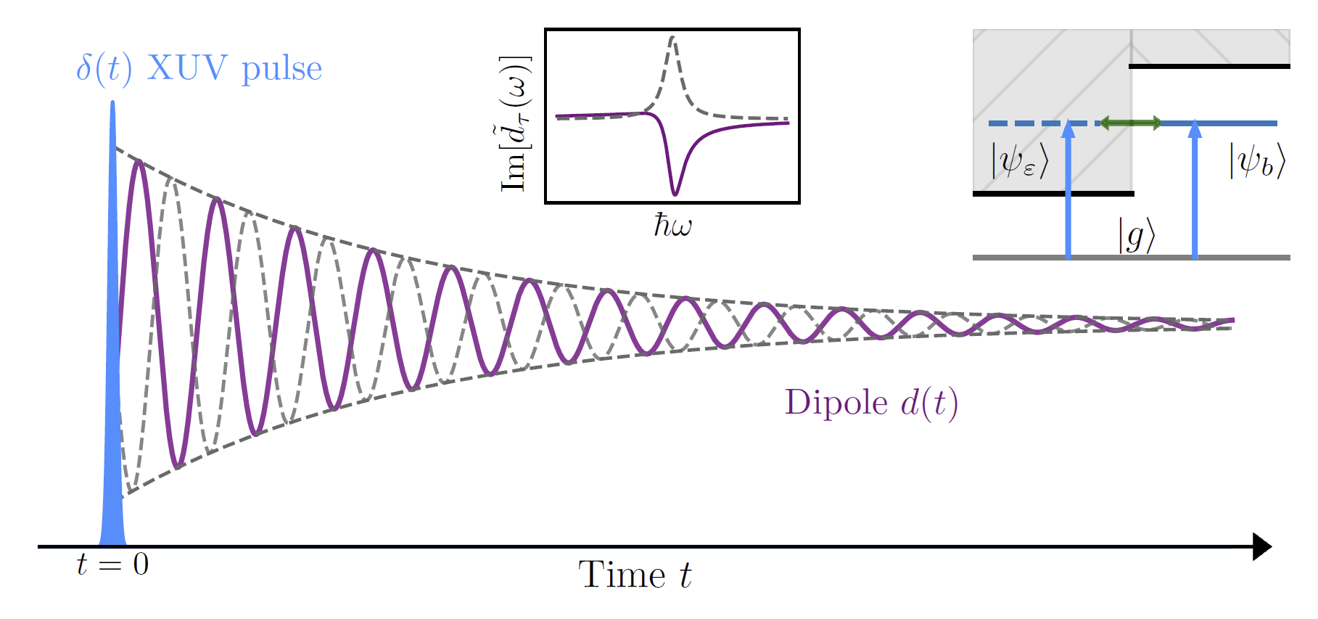

Slide 29
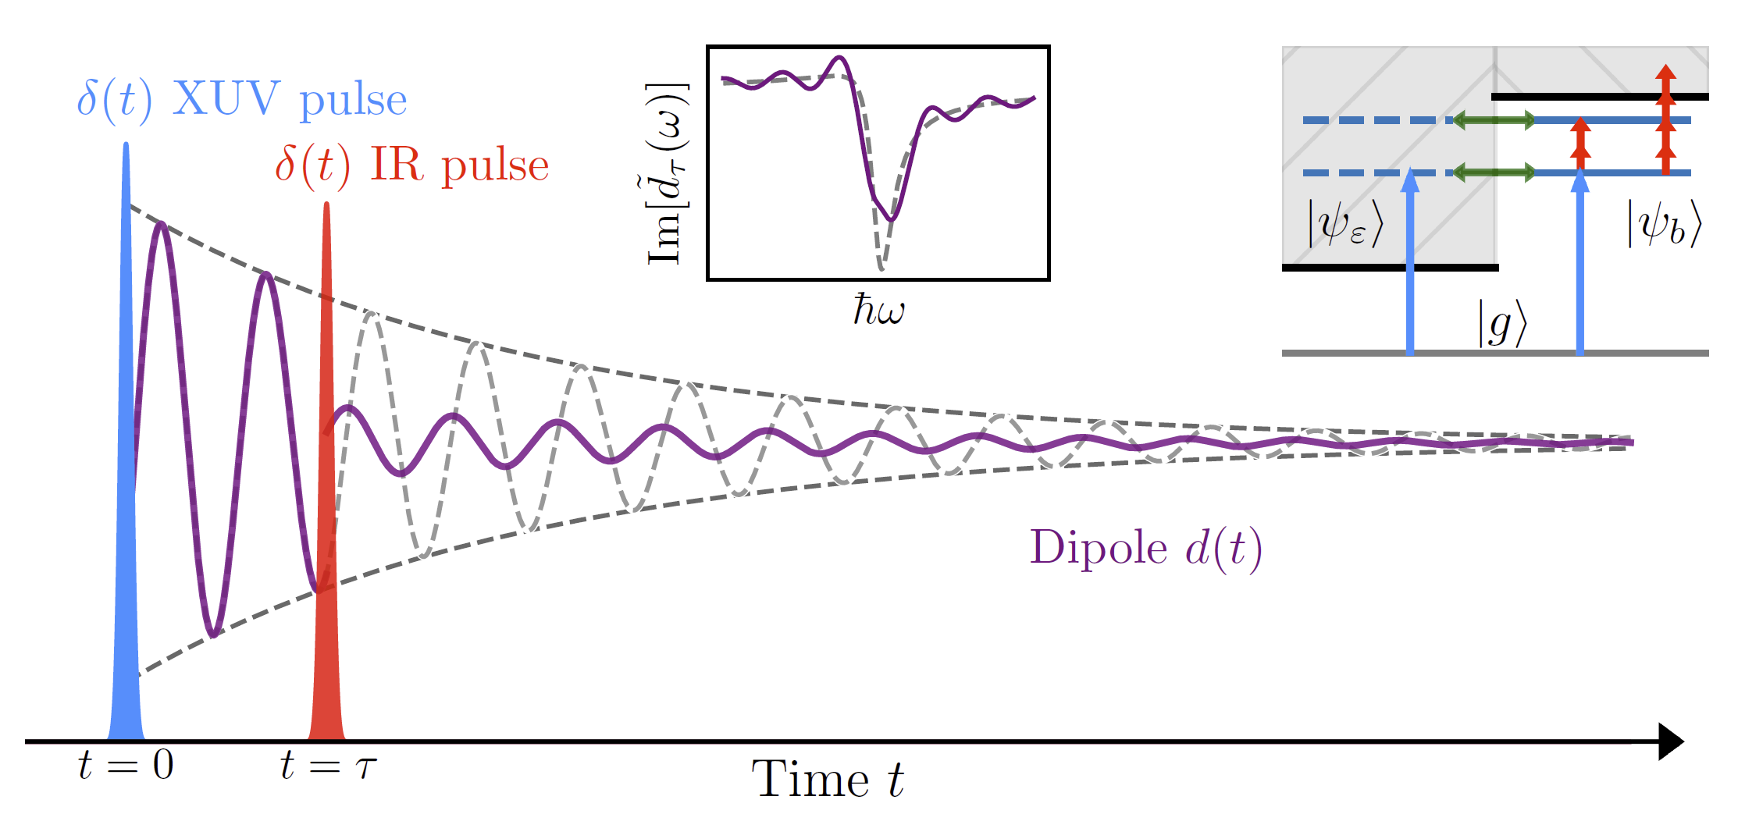
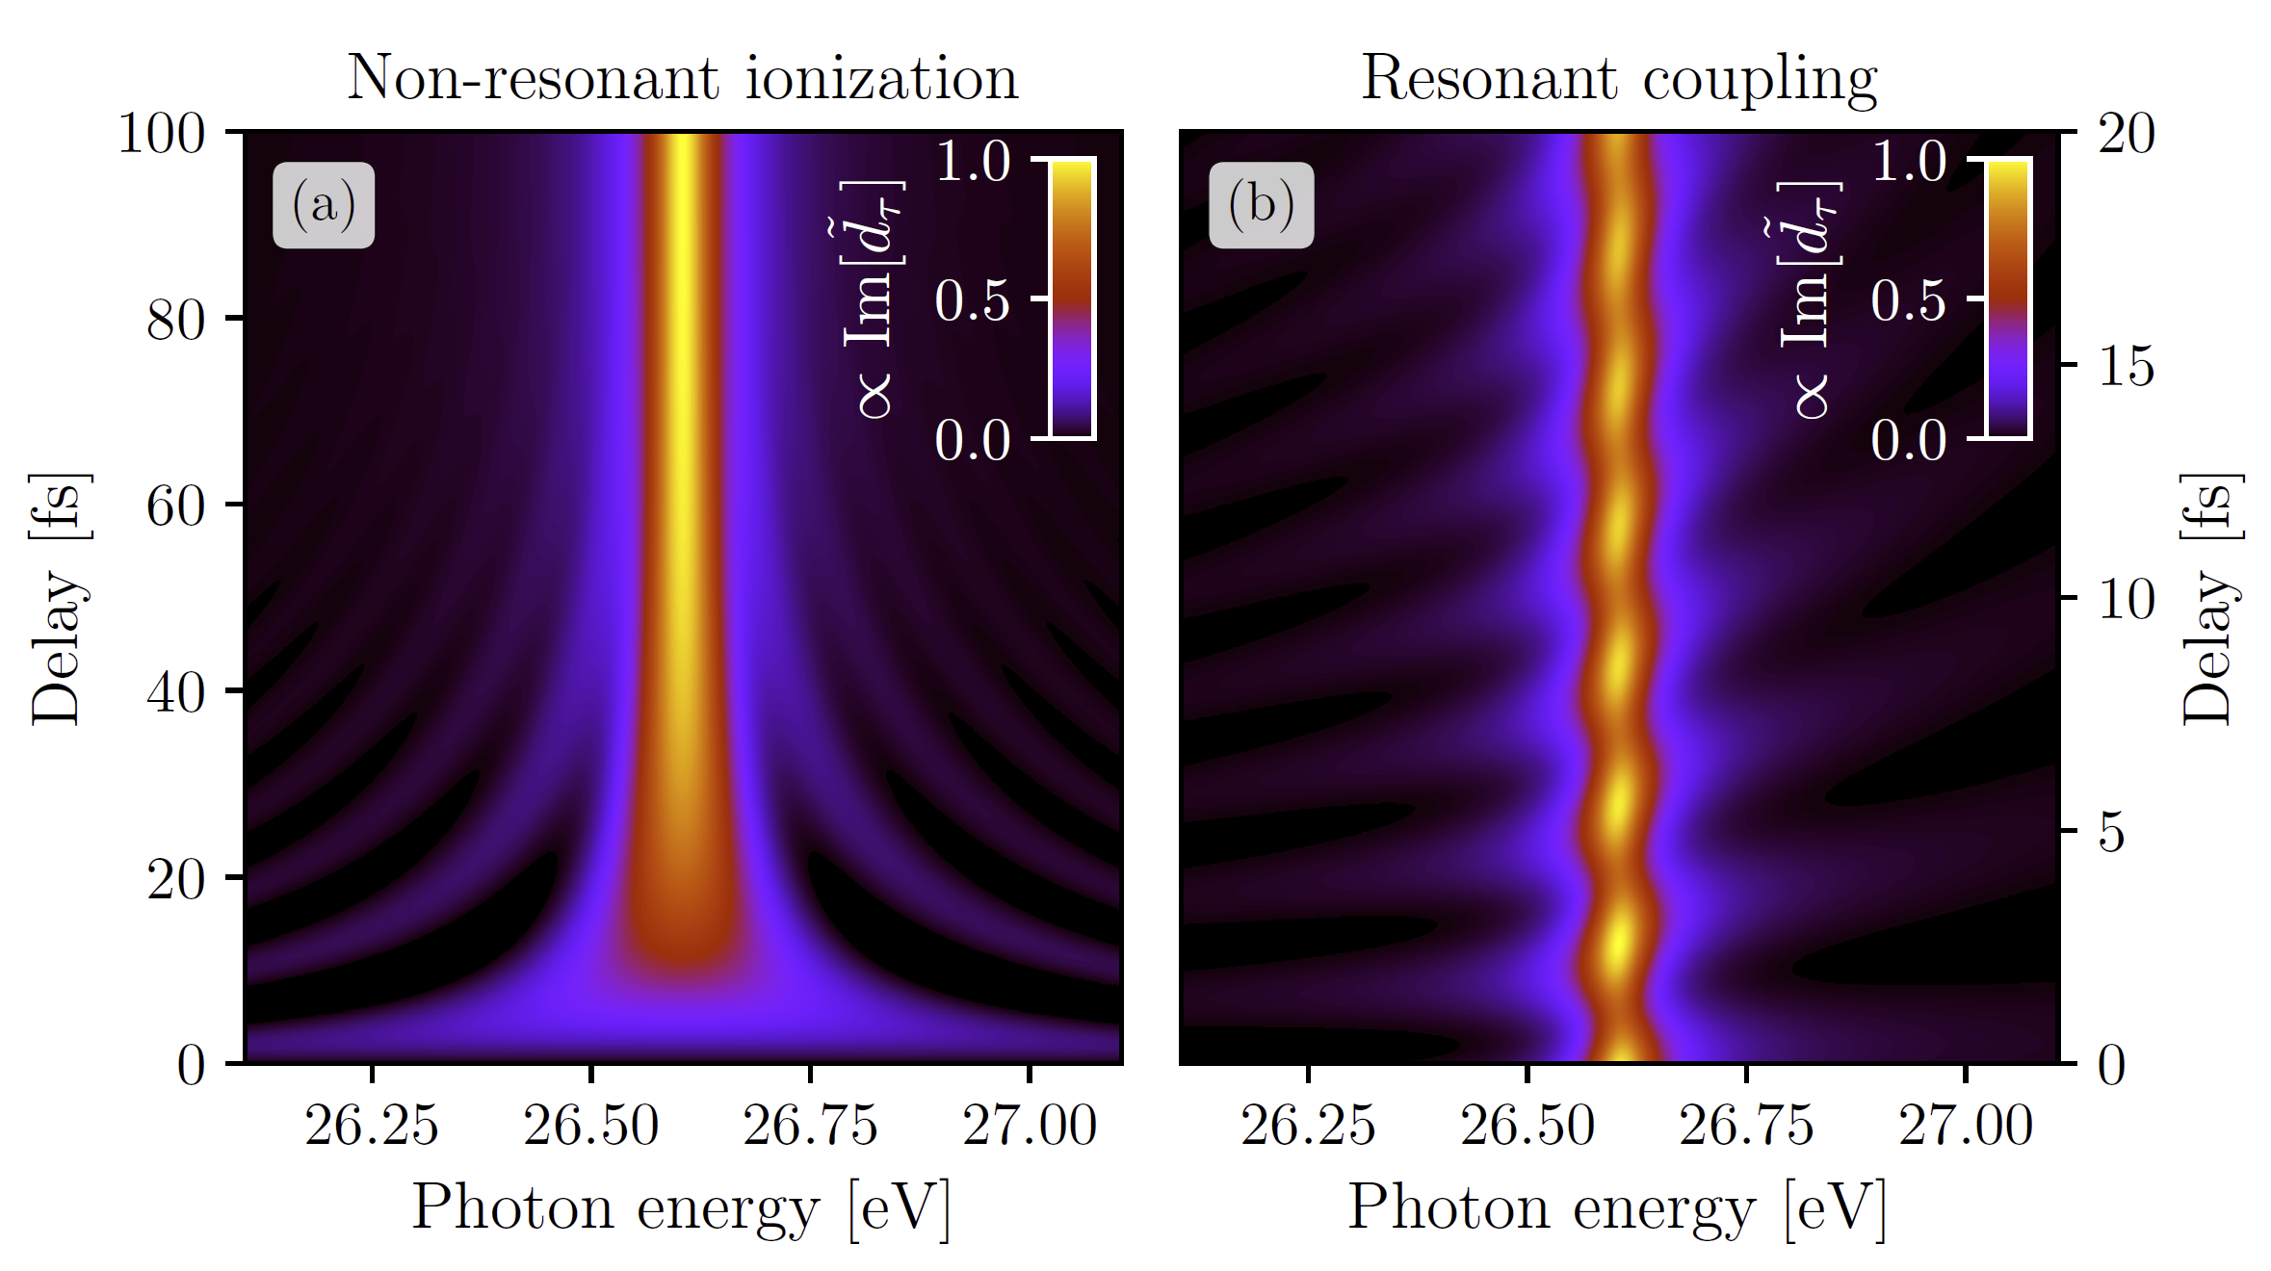
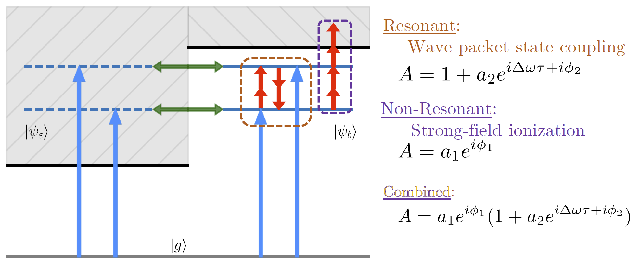

Slide 30
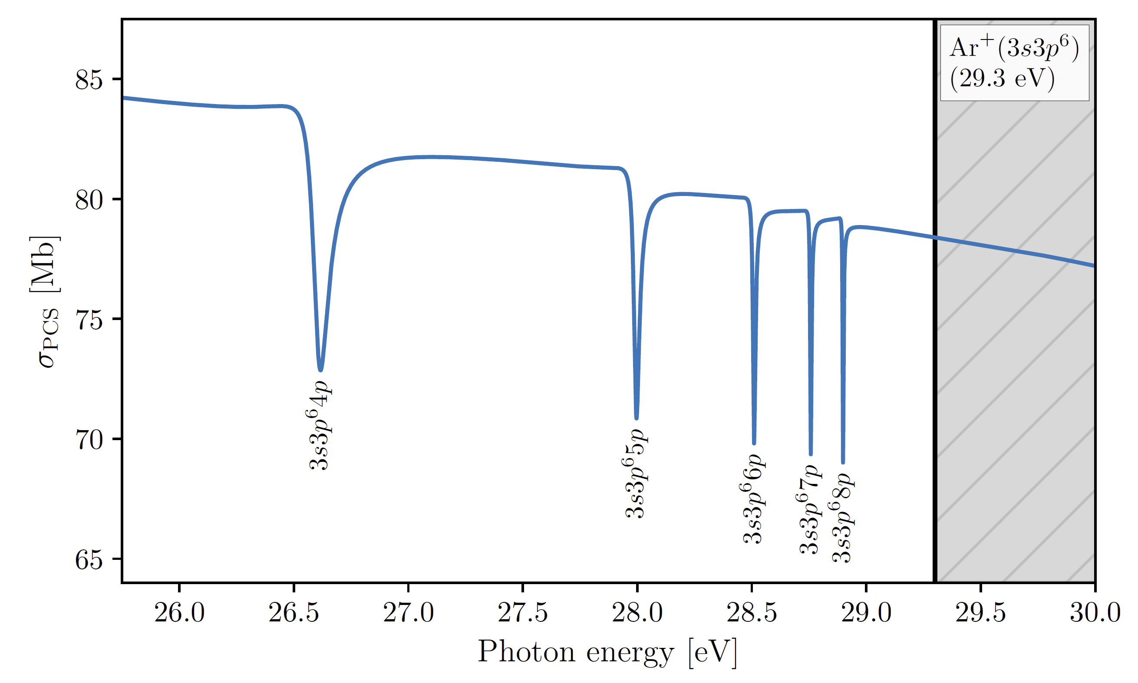
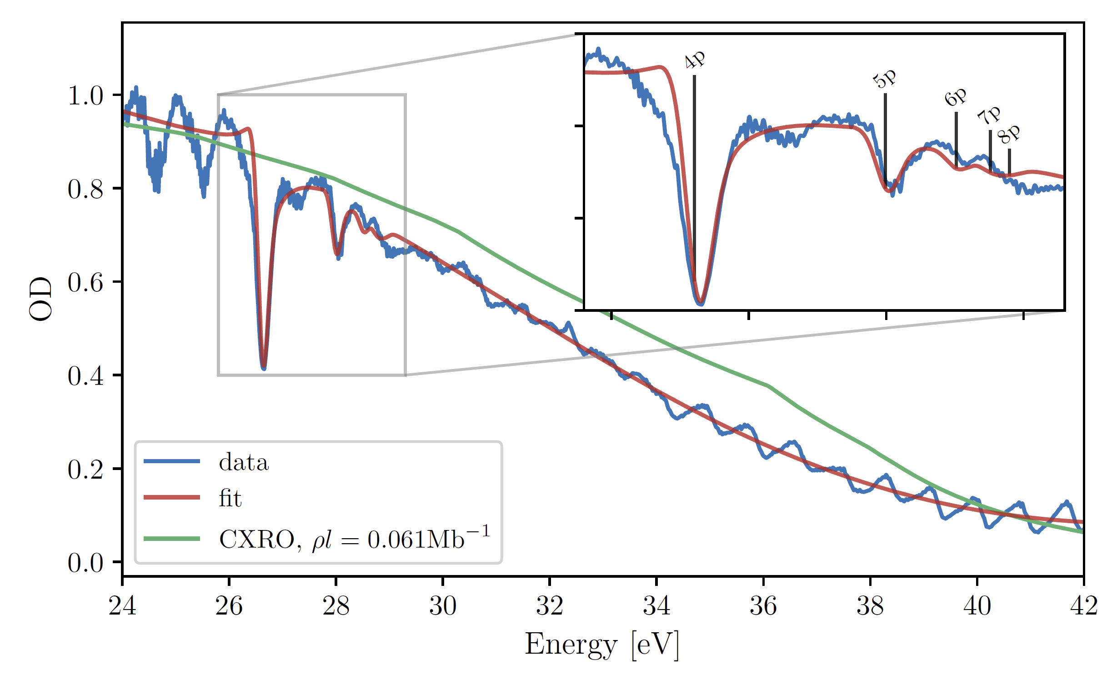


Slide 31


Slide 32



Slide 34





Slide 35



Slide 36


Slide 37


Slide 38


Slide 39





Slide 40





Slide 41



Slide 42


Slide 43




